Slide 1
Application Delivery Fundamentals 2.0 B: Java
Micro Service

Slide 2
Micro Service
Goals
Independent deployment of components
Independent scaling of components
Independent implementation stacks for each component
Easy self-serve deployments of components
Repeatable deployments of components (external configuration management)
Deployments without service interruptions

Slide 3
Micro Service
Goals
Protection of system availability from individual Instance failure
Automatic replacement of component instances when they fail (self-healing)
Easy scaling of components by adjusting a simple parameter value
Canary testing
"Red/black" or "blue/green" deployments
Instant reversal of new revision deployments

Slide 4
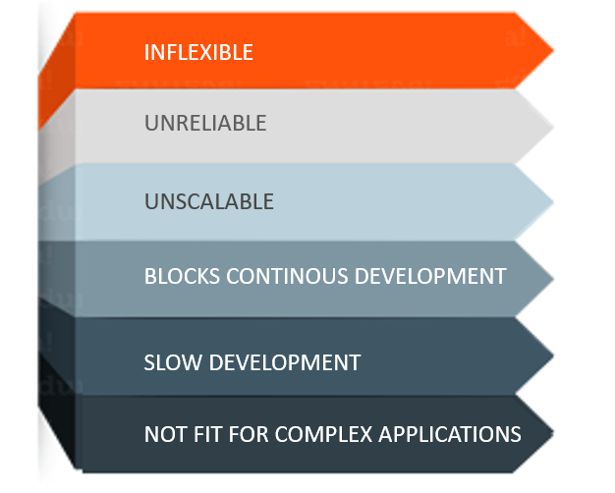
Monolithic Architecture

Slide 5
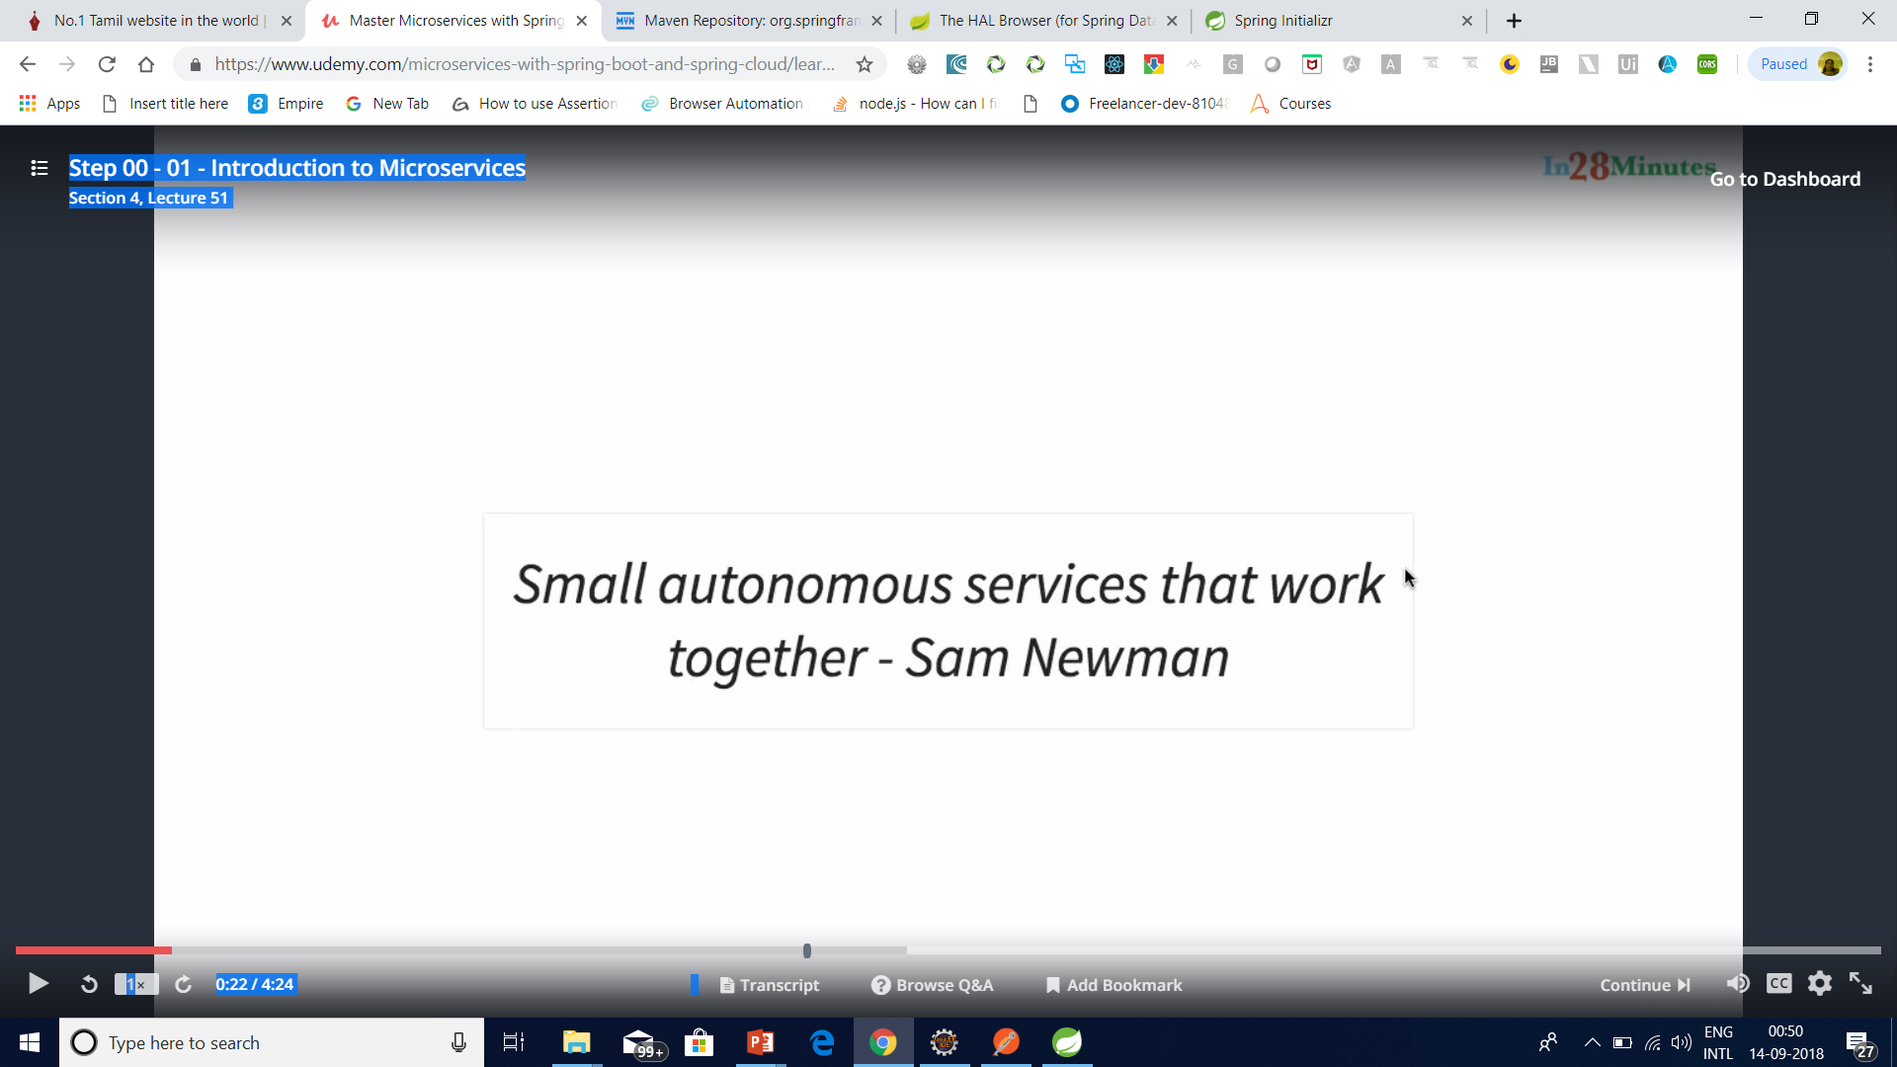
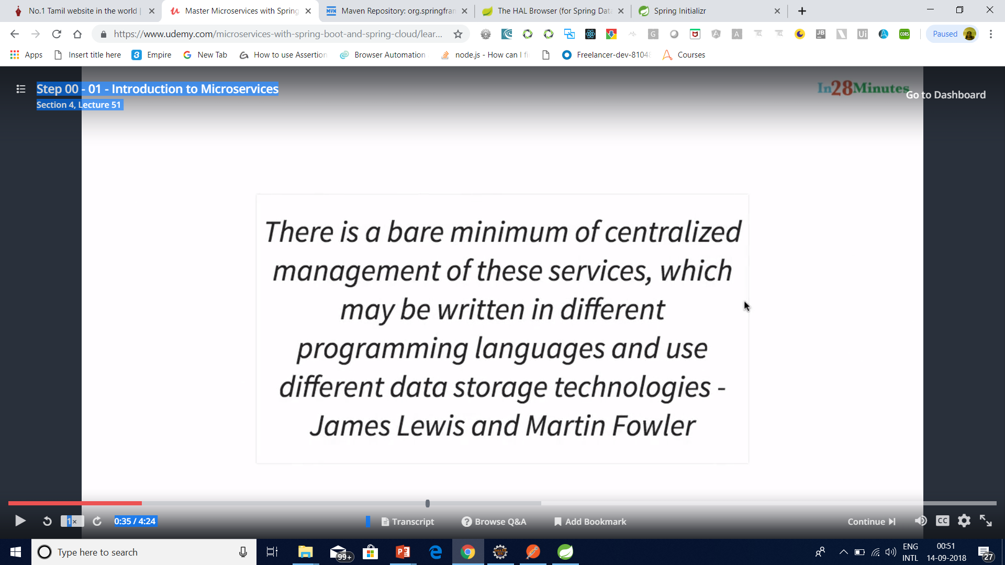
Micro Service

Slide 6
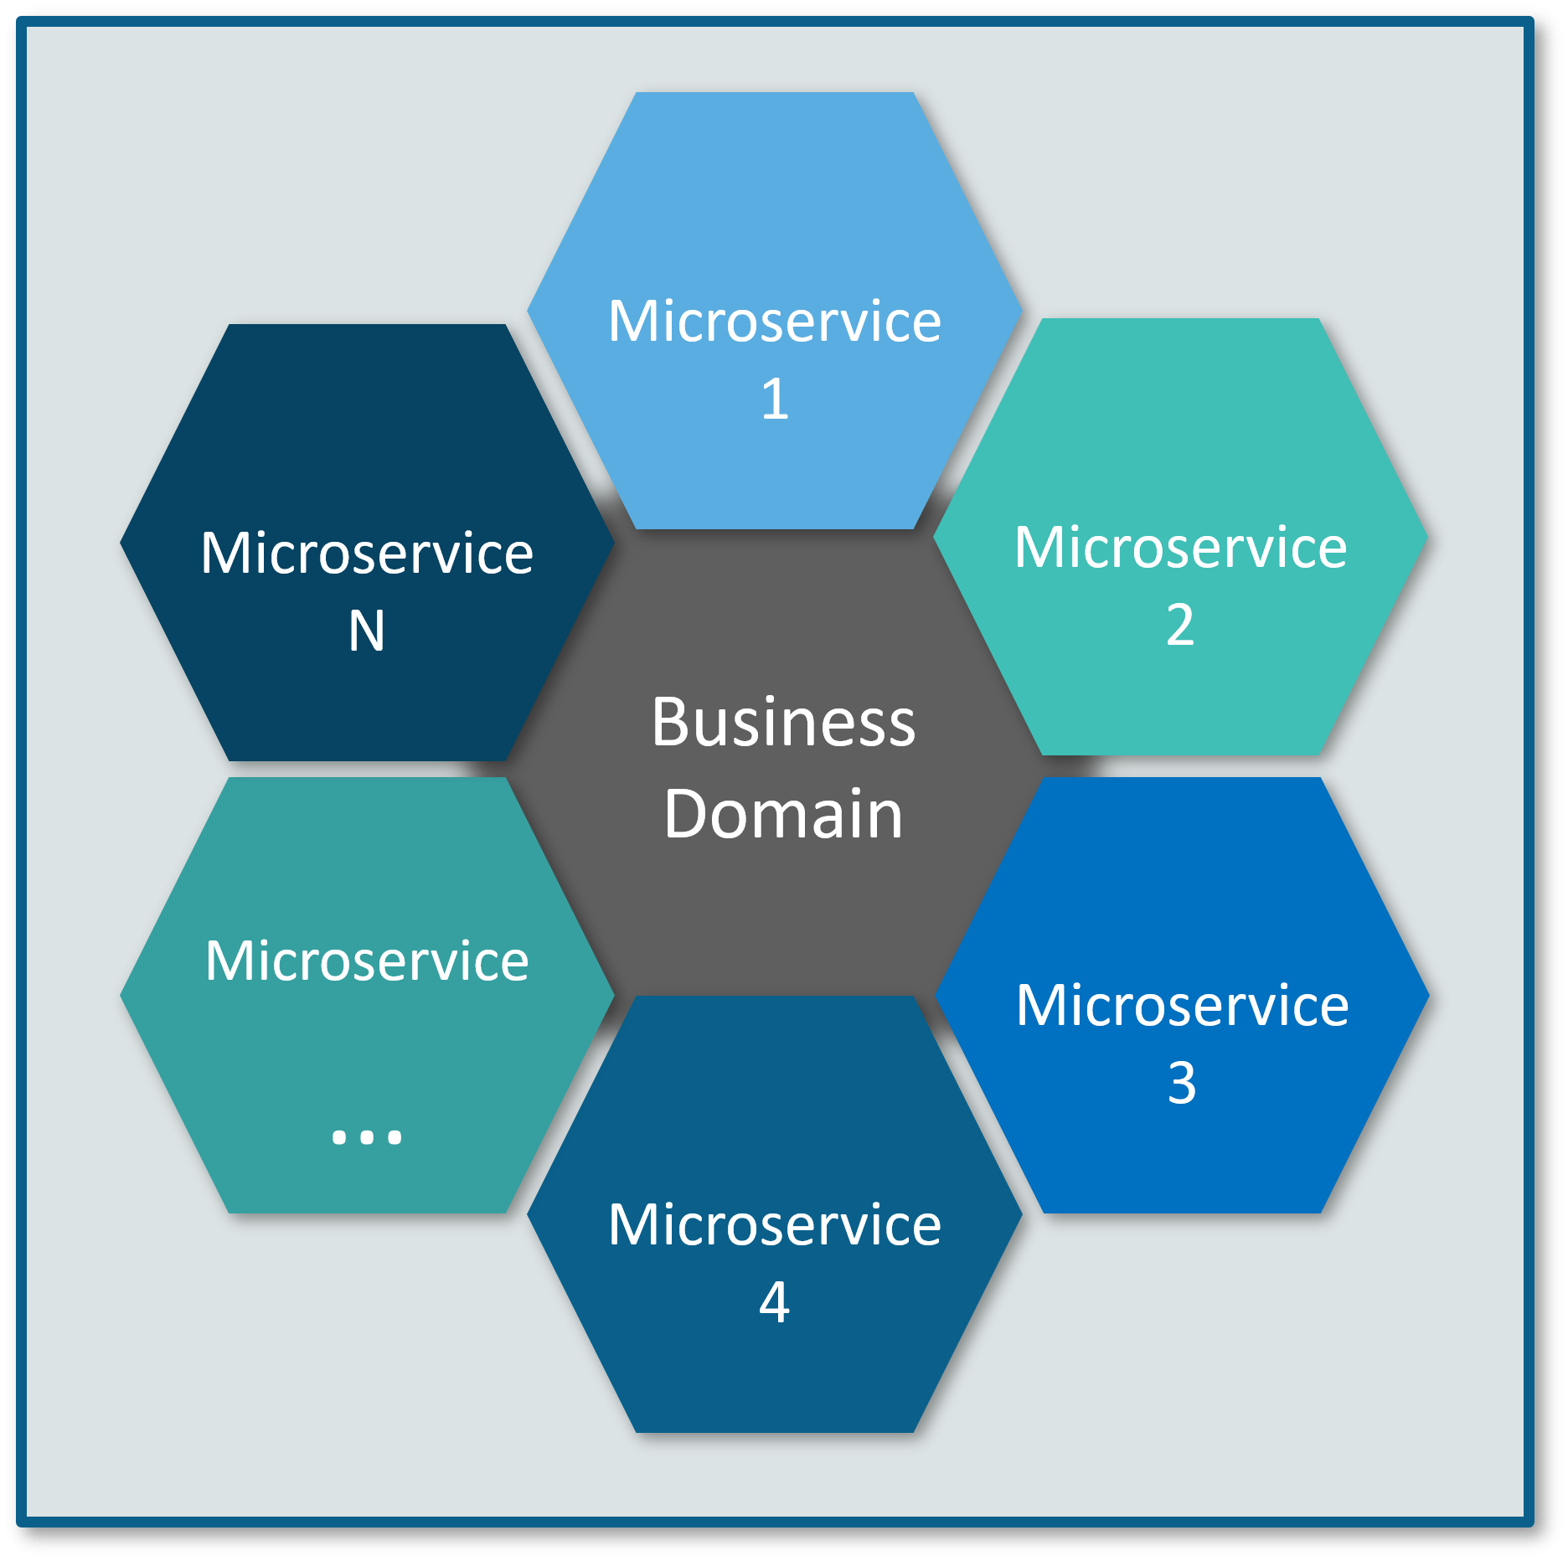
Microservice

Slide 7

Micro Service

Slide 8
Micro Service

Slide 9

Micro Service

Slide 10

Micro Service

Slide 11
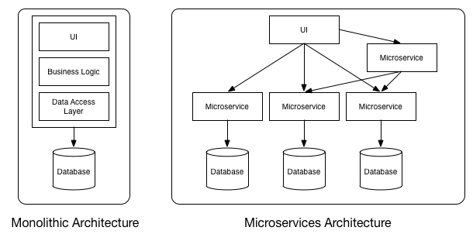
MicroService

Slide 12
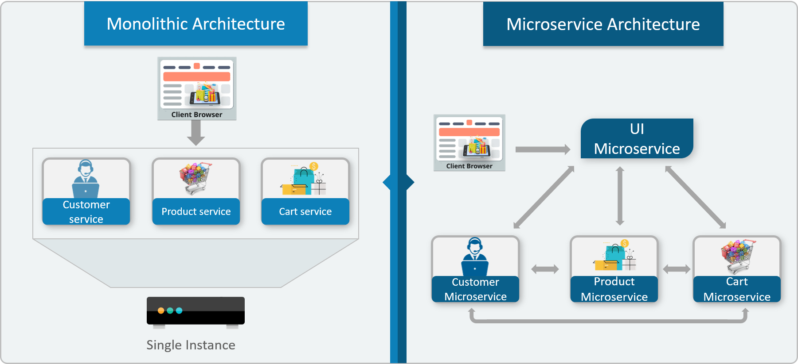

Slide 13
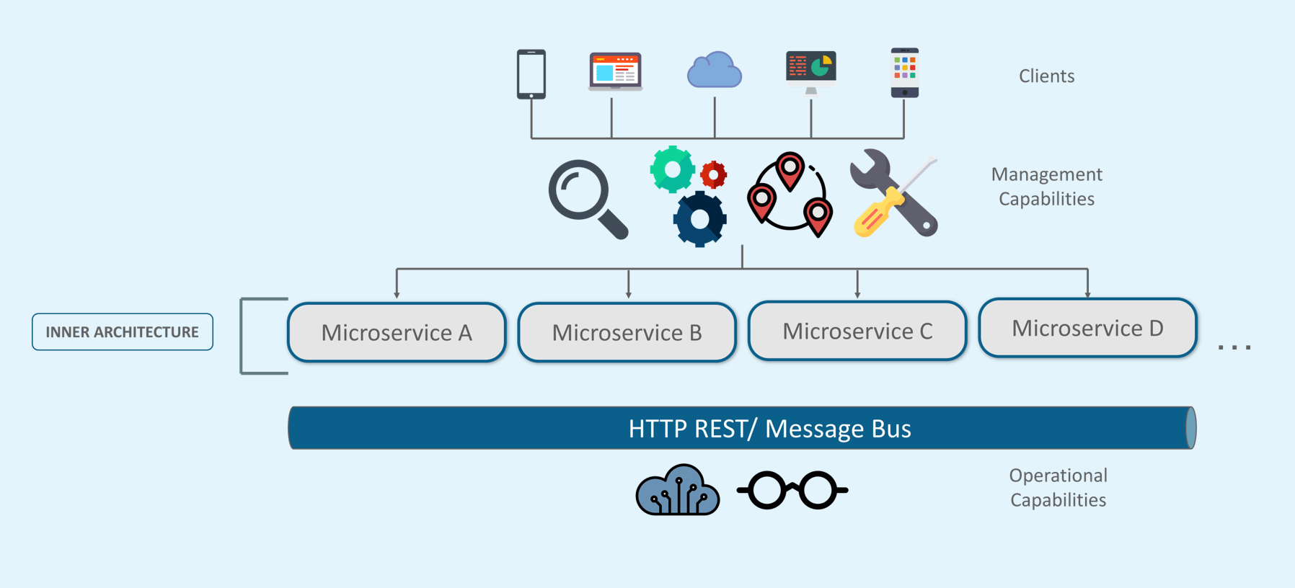
Microservice Architecture

Slide 14
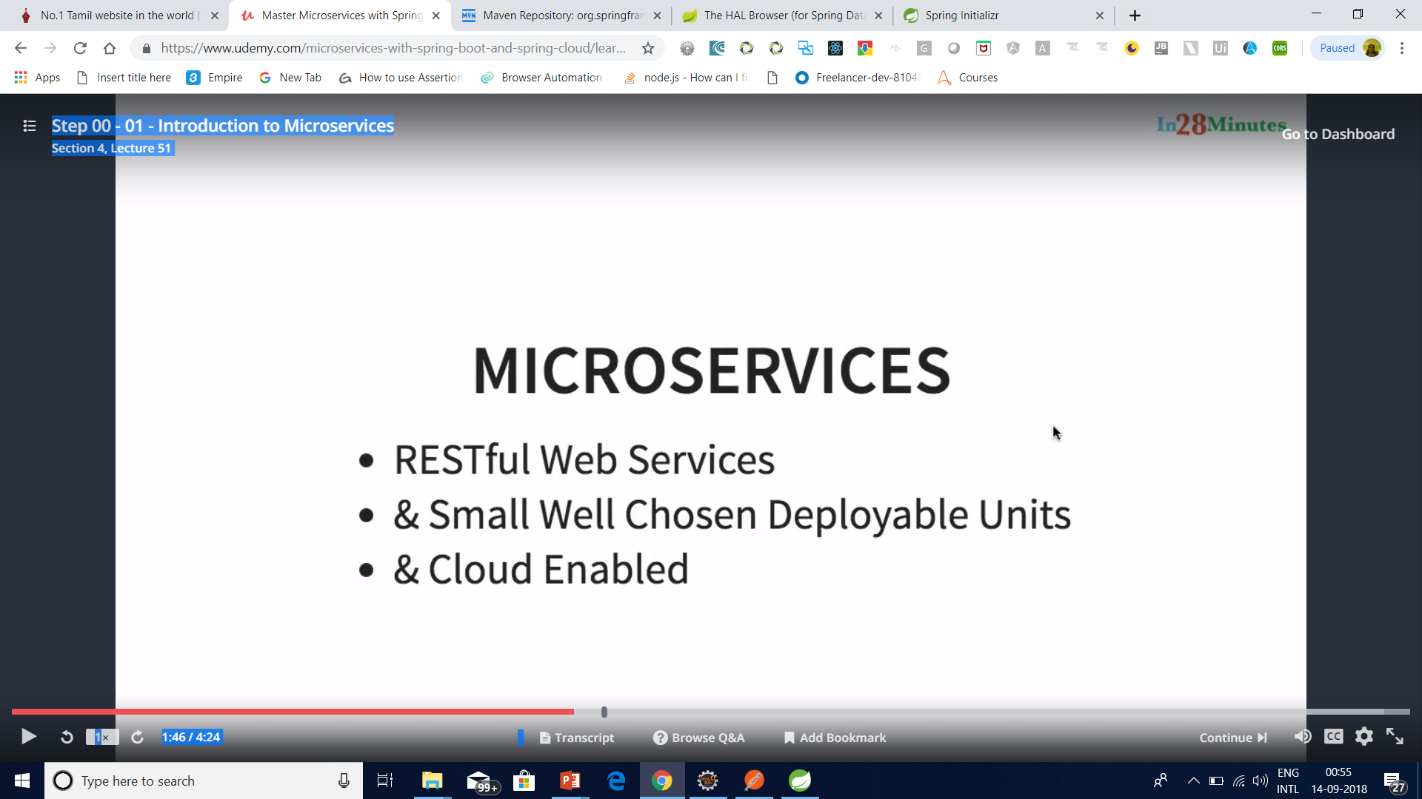
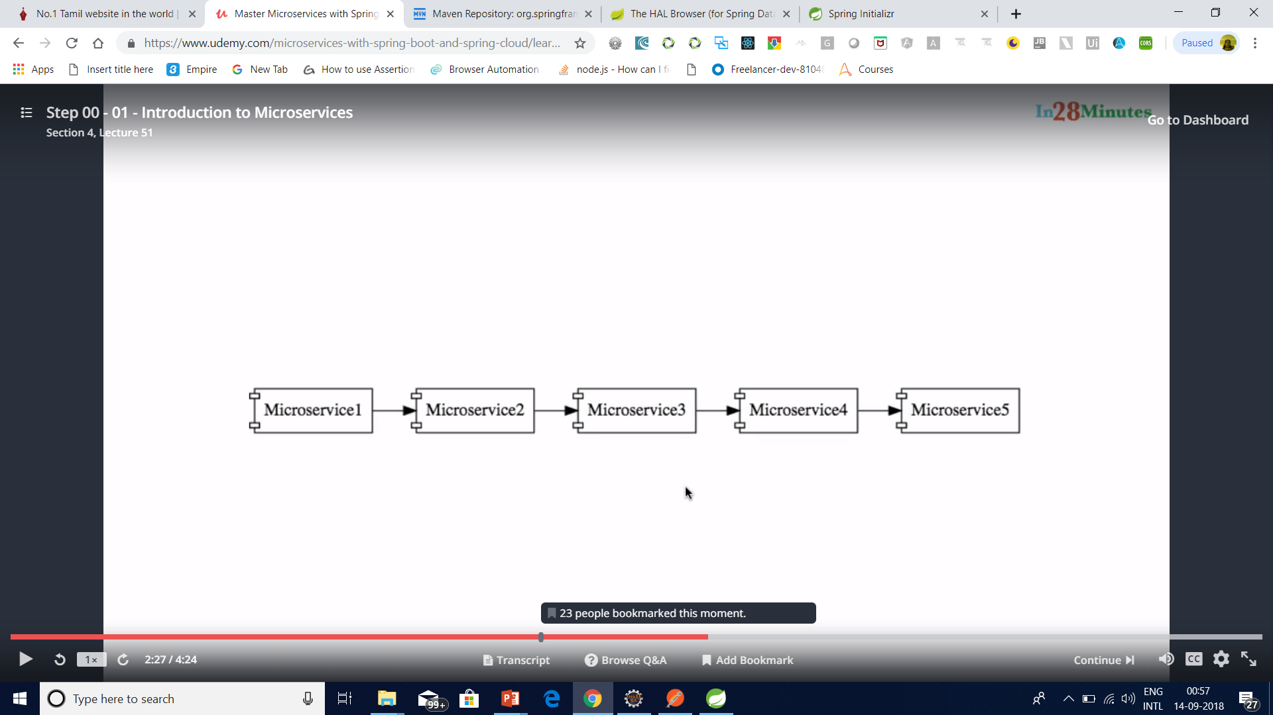
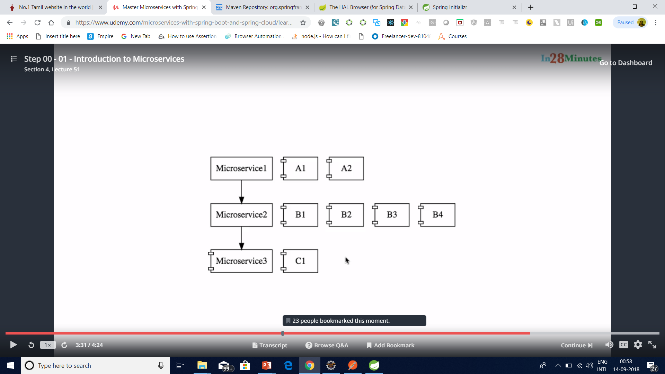
Micro Service

Slide 15
What is Microservices
Microservices is a variant of the service-oriented architecture (SOA) architectural style that structures an application as a collection of loosely coupled services.

Slide 16
What is Microservices
In a microservices architecture, services should be fine-grained and the protocols should be lightweight.
The benefit of decomposing an application into different smaller services is that it improves modularity and makes the application easier to understand, develop and test.

Slide 17
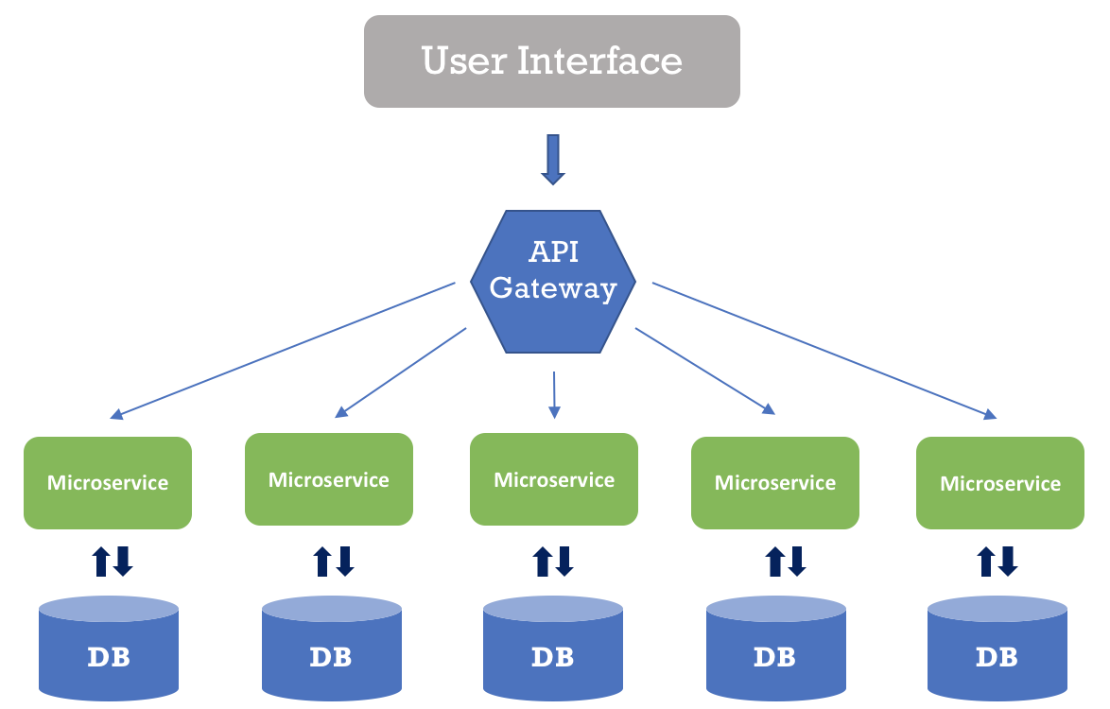
What is Microservices
It also parallelizes development by enabling small autonomous teams to develop, deploy and scale their respective services independently.

Slide 18
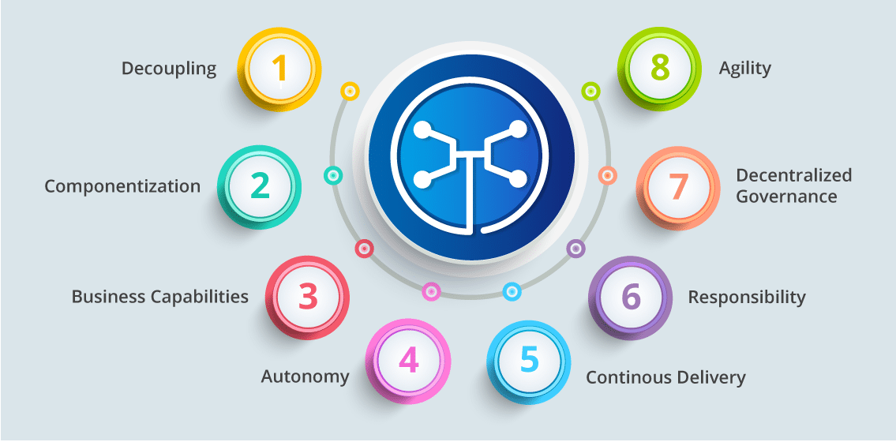
Microservices Features

Slide 19
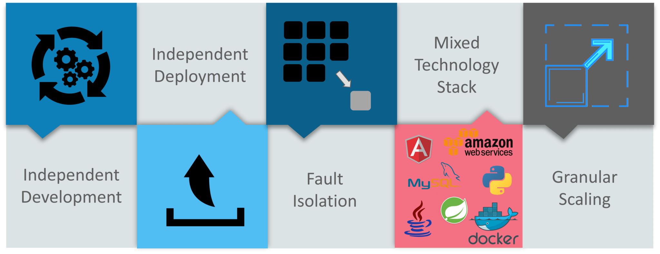
Advantages Of Microservices

Slide 20
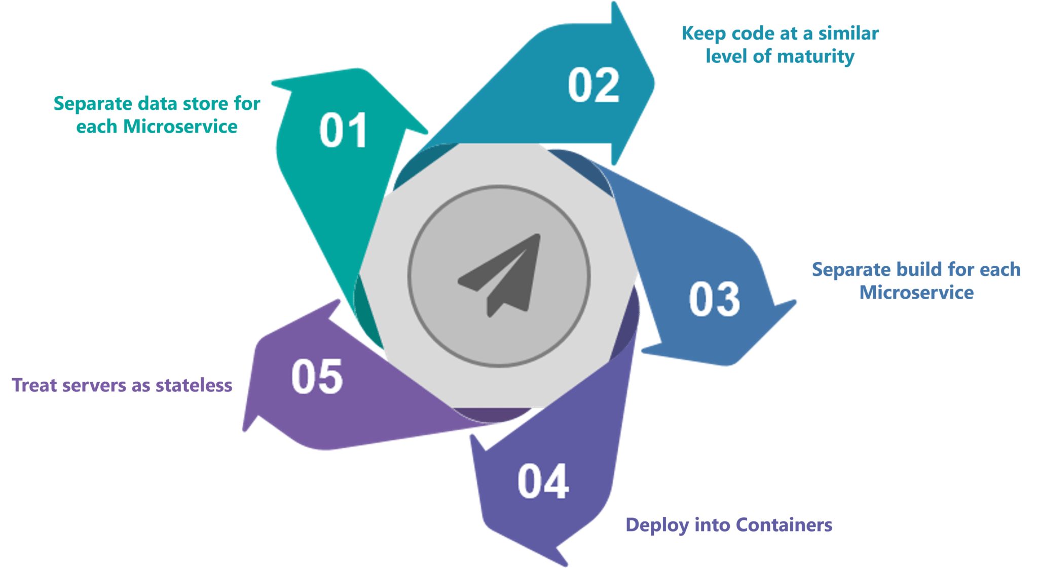
Best Practices To Design Microservices

Slide 21
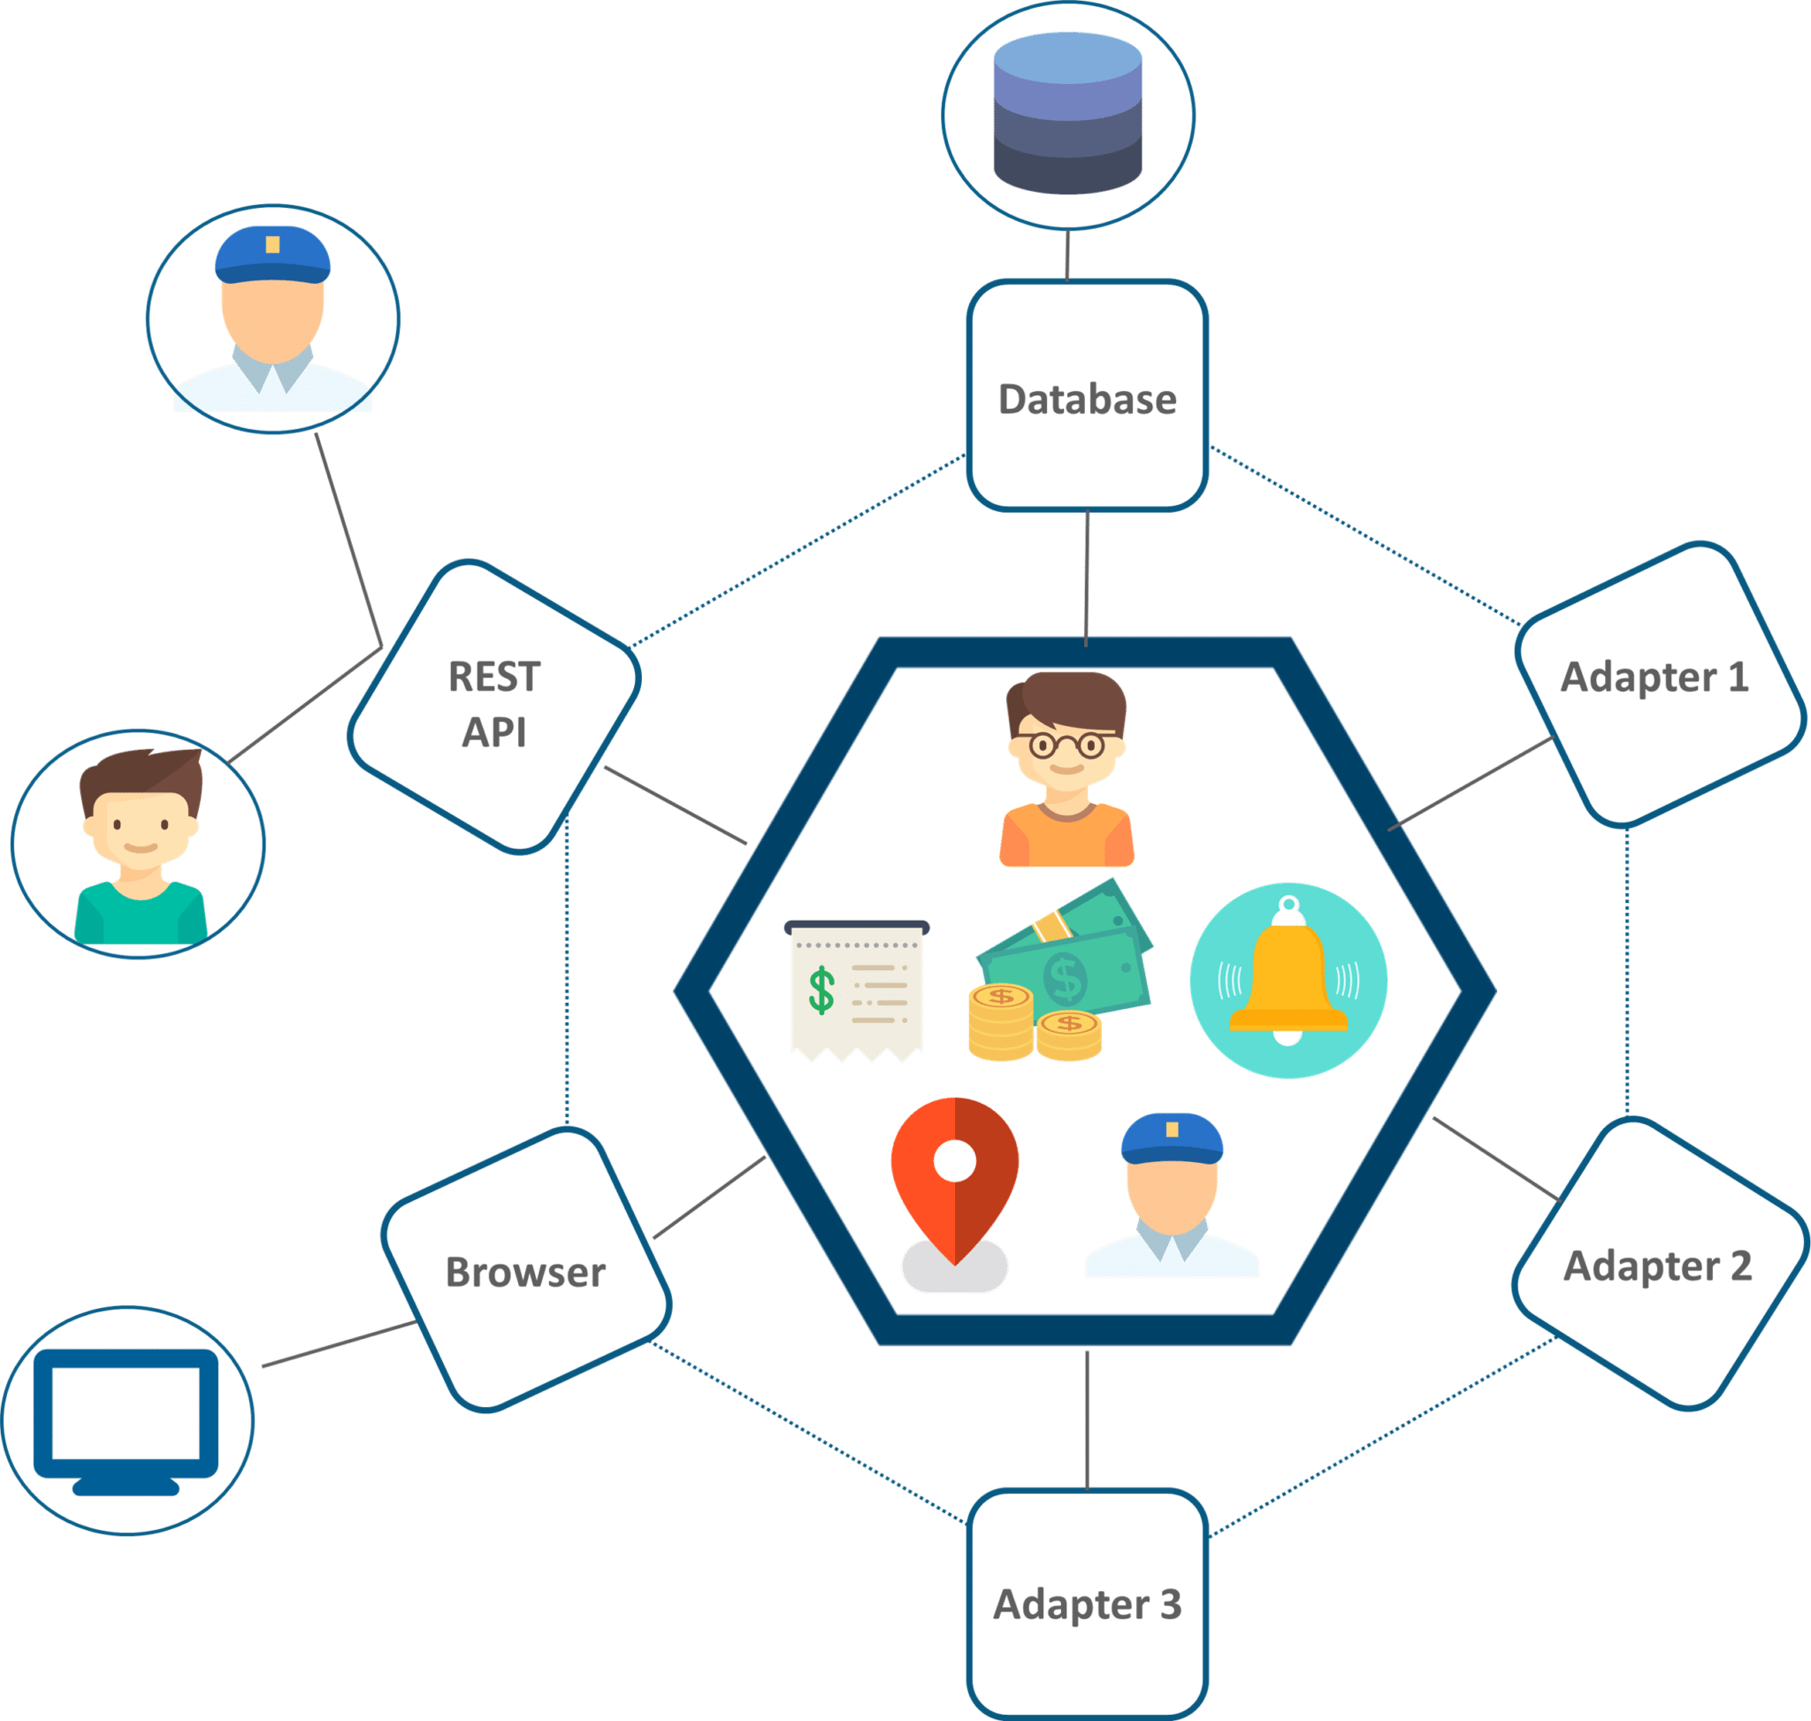
UBER CASE STUDY
UBER’s Previous Architecture

Slide 22
Problem Statement
While UBER started expanding worldwide this kind of framework introduced various challenges. The following are some of the prominent challenges
All the features had to be re-built, deployed and tested again and again to update a single feature.
Fixing bugs became extremely difficult in a single repository as developers had to change the code again and again.
Scaling the features simultaneously with the introduction of new features worldwide was quite tough to be handled together.

Slide 23
Solution
To avoid such problems UBER decided to change its architecture and follow the other hyper-growth companies like Amazon, Netflix, Twitter and many others.
Thus, UBER decided to break its monolithic architecture into multiple codebases to form a microservice architecture.

Slide 24
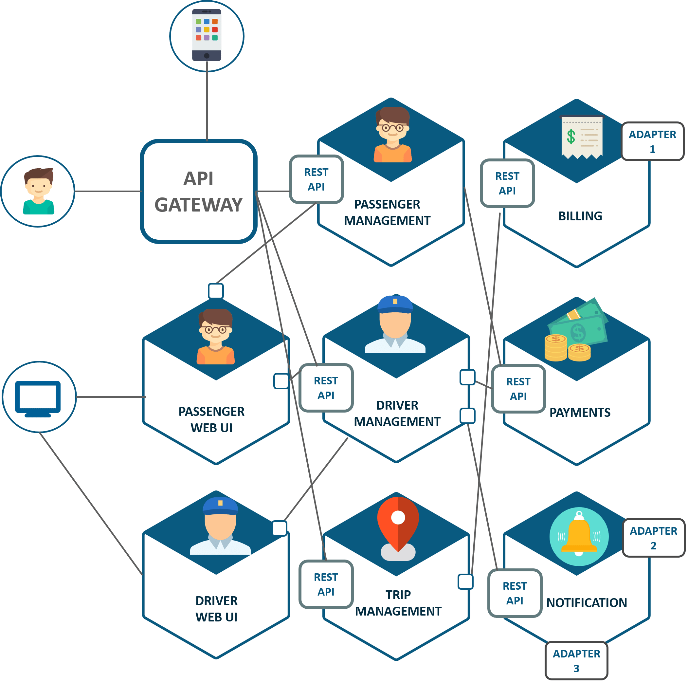

Slide 25
What are the Benefits of Microservices?
Smaller applications are not dependent on the same coding language, the developers can use the programming language that they are most familiar with.
That helps developers come up with a program faster with lower costs and fewer bugs.
The agility and low costs can also come from being able to reuse these smaller programs on other projects, making it more efficient.

Slide 26
Existing Scenarios
Netflix has a widespread architecture that has evolved from monolithic to SOA. It receives more than one billioncalls every day, from more than 800 different types of devices, to its streaming-video API. Each API call then prompts around five additional calls to the backend service.
Amazon has also migrated to microservices. They get countless calls from a variety of applications—including applications that manage the web service API as well as the website itself—which would have been simply impossible for their old, two-tiered architecture to handle.
The auction site eBay is yet another example that has gone through the same transition. Their core application comprises several autonomous applications, with each one executing the business logic for different function areas.

Slide 27
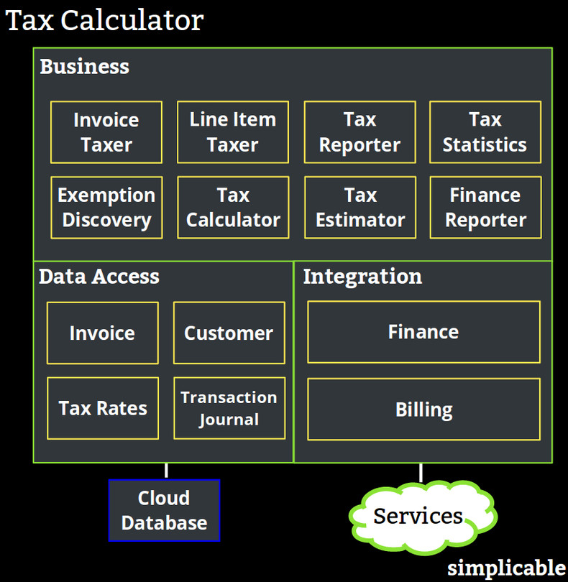

Slide 28
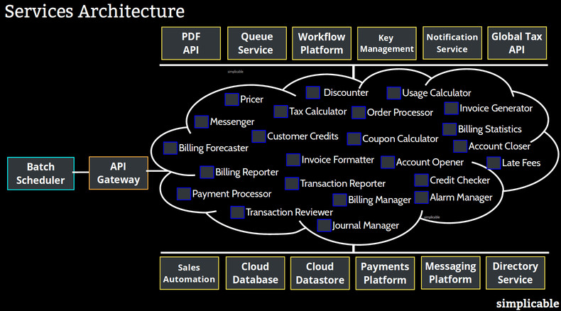

Slide 29
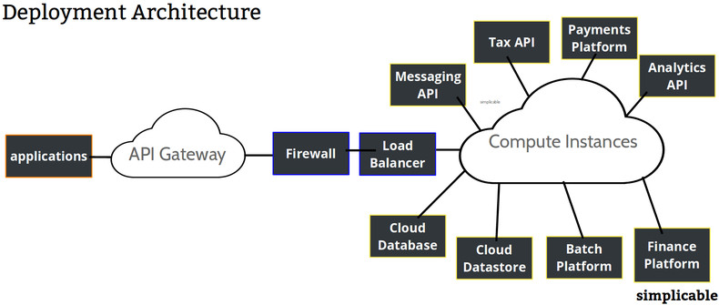

Slide 30
Principles of Microservices
Single responsibility principle
The single responsibility principle is one of the principles defined as part of the SOLID design pattern. It implies that a unit, either a class, a function, or a microservice, should have one and only one responsibility.
At no point of time, one microservice should have more than one responsibility.

Slide 31
Principles of Microservices
Built around business capabilities
Microservices should focus on certain business function and ensure that it helps in getting things done. A microservice shall never restrict itself from adopting appropriate technology stack or backend database storage which is most suitable for solving the business purpose.
This is often the constraint when we design monolithic applications where we try to solve multiple business solutions with some compromises in some areas. Microservices enable you to choose whats best for the problem in hand.

Slide 32
Principles of Microservices
You build it, you own it!
Another important aspect of such design is related to responsibilities pre-and-post development. In large organization, usually one team develops the app location, and after some knowledge transfer sessions it hand over the project to maintenance team. In microservices, the team which build the service – owns it, and is responsible for maintaining it in future.

Slide 33
Principles of Microservices
Infrastructure Automation
Preparing and building infrastructure for microservices is another very important need. A service shall be independently deployableand shall bundle all dependencies, including library dependencies, and even execution environments such as web servers and containers or virtual machines that abstract physical resources.
One of the major differences between microservices and SOA is in their level of autonomy. While most SOA implementations provide service-level abstraction, microservices go further and abstract the realization and execution environment.

Slide 34
Principles of Microservices
Infrastructure Automation
In traditional application developments, we build a WAR or an EAR, then deploy it into a JEE application server, such as with JBoss, WebLogic, WebSphere, and so on. We may deploy multiple applications into the same JEE container. In ideal scenario, in the microservices approach, each microservice will be built as a fat Jar, embedding all dependencies and run as a standalone Java process.

Slide 35
Principles of Microservices
Design for Failure
A microservice shall be designed with failure cases in mind. What if the service fails, or go down for some time. These are very important questions and must be solved before actual coding starts – to clearly estimate how service failures will affect the user experience.
Fail fast is another concept used to build fault-tolerant, resilient systems. This philosophy advocates systems that expect failures versus building systems that never fail. Since services can fail at any time, it’s important to be able to detect the failures quickly and, if possible, automatically restore service.

Slide 36
Principles of Microservices
Design for Failure
Microservice applications put a lot of emphasis on real-time monitoring of the application, checking both architectural elements (how many requests per second is the database getting) and business relevant metrics (such as how many orders per minute are received). Semantic monitoring can provide an early warning system of something going wrong that triggers development teams to follow up and investigate.

Slide 37
Benefits of Microservices
With microservices, architects and developers can choose fit for purpose architectures and technologies for each microservice (polyglot architecture). This gives the flexibility to design better-fit solutions in a more cost-effective way.
As services are fairly simple and smaller in size, enterprises can afford to experiment new processes, algorithms, business logic, and so on. It enables enterprises to do disruptive innovation by offering the ability to experiment and fail fast.

Slide 38
Benefits of Microservices
Microservices enable to implement selective scalability i.e. each service could be independently scaled up or down and cost of scaling is comparatively less than monolithic approach.
Microservices are self-contained, independent deployment modules enabling the substitution of one microservice with another similar microservice, when second one is not performing as per our need. It helps in taking right buy-versus-build decisions which are often the challenge for many enterprises.

Slide 39
Benefits of Microservices
Microservices help us build systems that are organic in nature(Organic systems are systems that grow laterally over a period of time by adding more and more functions to it). Because microservices are all about independently manageable services – it enable to add more and more services as the need arises with minimal impact on the existing services.
Technology changes are one of the barriers in software development. With microservices, it is possible to change or upgrade technology for each service individually rather than upgrading an entire application.

Slide 40
Benefits of Microservices
As microservices package the service runtime environment along with the service itself, this enables having multiple versions of the service to coexist in the same environment.
And finally, microservices also enable smaller, focused agile teams for development. Teams will be organized based on the boundaries of microservices.

Slide 41
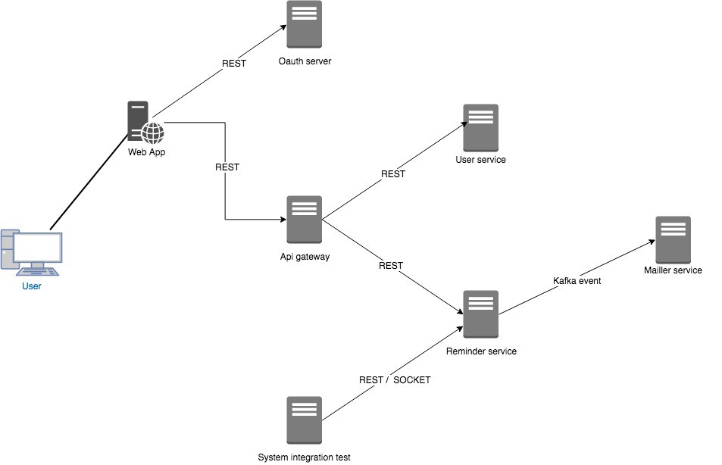

Slide 42
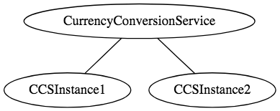
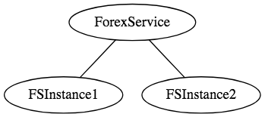
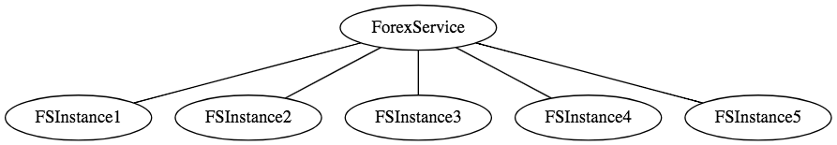
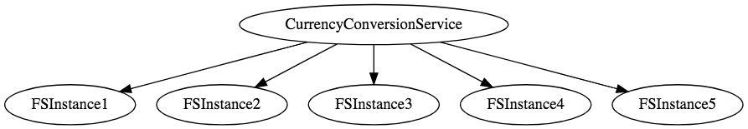

Slide 43
Examples of Microservices Frameworks for Java
There are several microservices frameworks that you can use for developing for Java. Some of these are:
Spring Boot. This is probably the best Java microservices framework that works on top of languages for Inversion of Control, Aspect Oriented Programming, and others.
Jersey. This open source framework supports JAX-RS APIs in Java is very easy to use.
Swagger. Helps you in documenting API as well as gives you a development portal, which allows users to test your APIs.

Slide 44
Pros
Microservice architecture gives developers the freedom to independently develop and deploy services
A microservice can be developed by a fairly small team
Code for different services can be written in different languages (though many practitioners discourage it)
Easy integration and automatic deployment (using open-source continuous integration tools such as Jenkins, Hudson, etc.)

Slide 45
Pros
Easy to understand and modify for developers, thus can help a new team member become productive quickly
The developers can make use of the latest technologies
The code is organized around business capabilities
Starts the web container more quickly, so the deployment is also faster

Slide 46
Pros
When change is required in a certain part of the application, only the related service can be modified and redeployed—no need to modify and redeploy the entire application
Better fault isolation: if one microservice fails, the other will continue to work (although one problematic area of a monolith application can jeopardize the entire system)
Easy to scale and integrate with third-party services
No long-term commitment to technology stack

Slide 47
Cons
Due to distributed deployment, testing can become complicated and tedious
Increasing number of services can result in information barriers
The architecture brings additional complexity as the developers have to mitigate fault tolerance, network latency, and deal with a variety of message formats as well as load balancing
Being a distributed system, it can result in duplication of effort

Slide 48
Cons
When number of services increases, integration and managing whole products can become complicated
In addition to several complexities of monolithic architecture, the developers have to deal with the additional complexity of a distributed system
Developers have to put additional effort into implementing the mechanism of communication between the services

Slide 49
Cons
Handling use cases that span more than one service without using distributed transactions is not only tough but also requires communication and cooperation between different teams
The architecture usually results in increased memory consumption
Partitioning the application into microservices is very much an art.

Slide 50
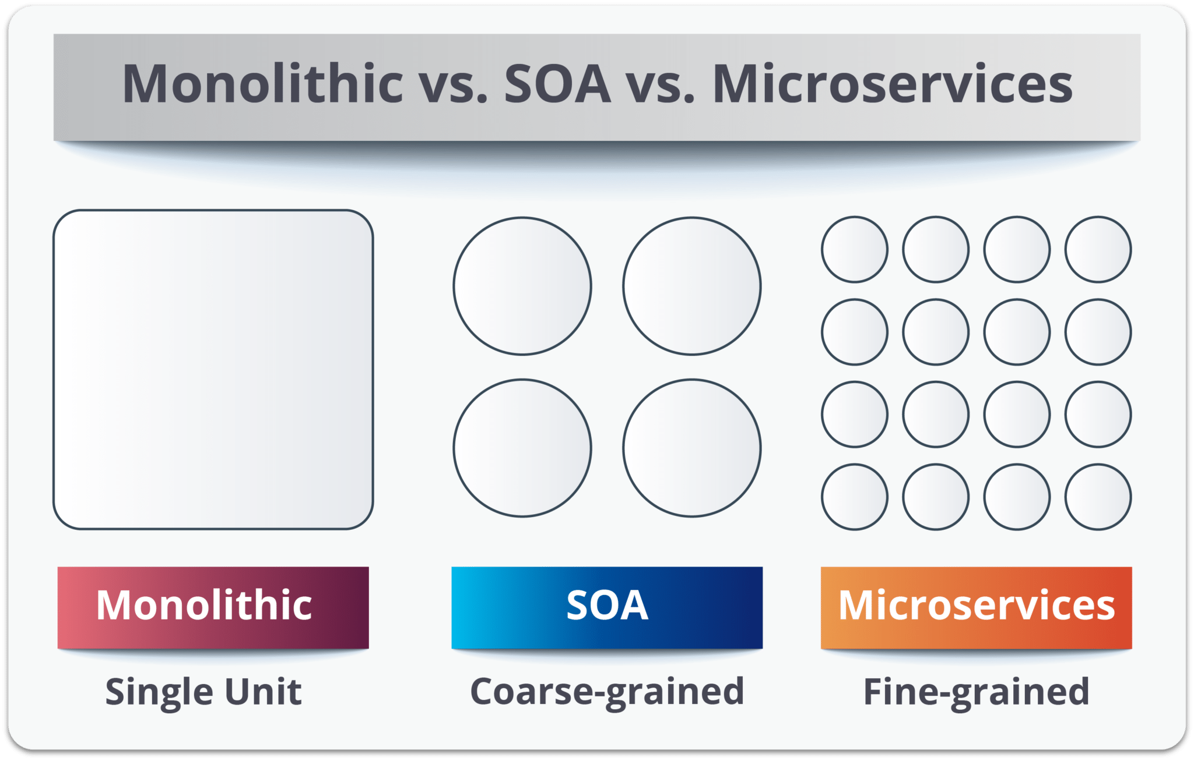
SOA vs Microservices

Slide 51
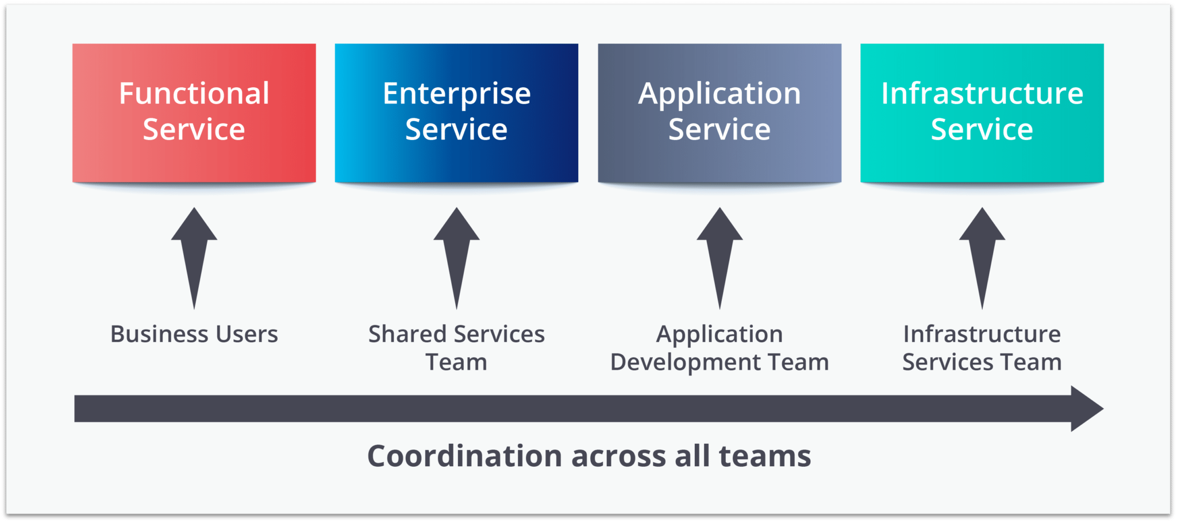
Service Oriented Architecture

Slide 52
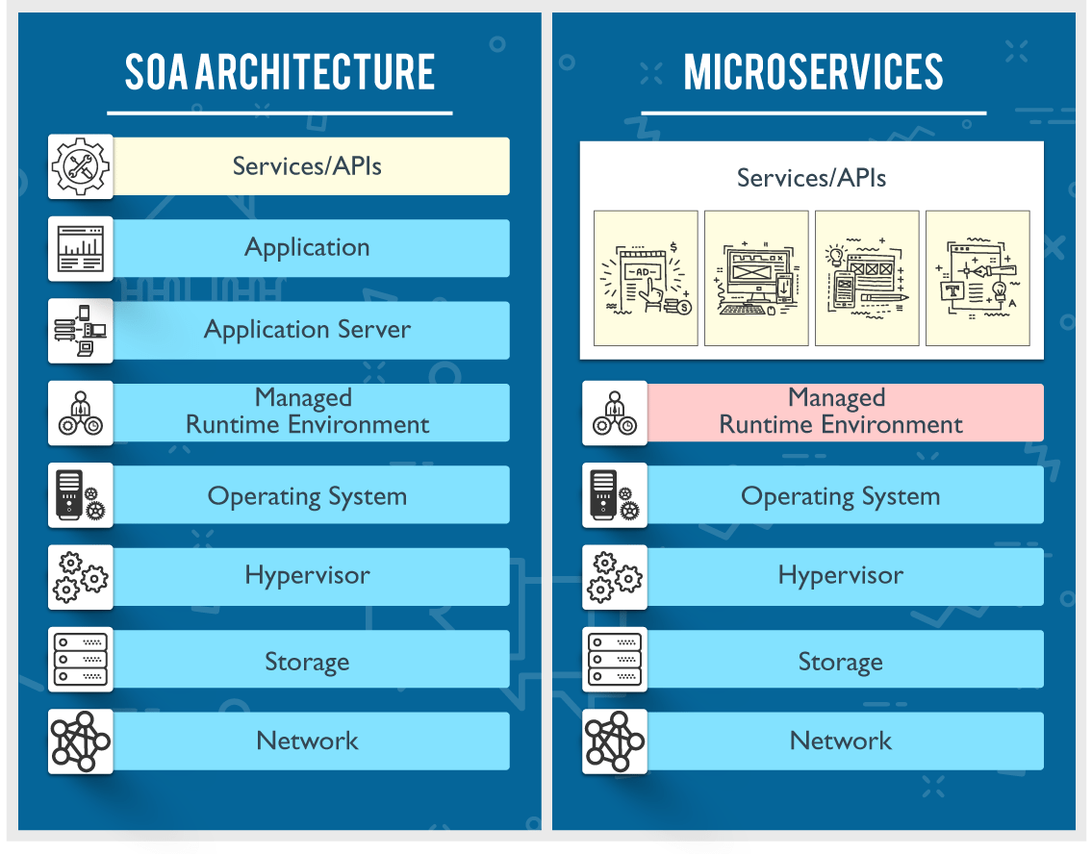

Slide 53
SOA | MSA
Follows “share-as-much-as-possible” architecture approach | Follows “share-as-little-as-possible” architecture approach
Importance is on business functionality reuse | Importance is on the concept of “bounded context”
They have common governance and standards | They focus on people collaboration and freedom of other options
Uses Enterprise Service bus (ESB) for communication | Simple messaging system
They support multiple message protocols | They use lightweight protocols such as HTTP/REST etc.
Multi-threaded with more overheads to handle I/O | Single-threaded usually with the use of Event Loop features for non-locking I/O handling
Maximizes application service reusability | Focuses on decoupling
Traditional Relational Databases are more often used | Modern Relational Databases are more often used
A systematic change requires modifying the monolith | A systematic change is to create a new service
DevOps / Continuous Delivery is becoming popular, but not yet mainstream | Strong focus on DevOps / Continuous Delivery

Slide 54
Challenges with Microservice Architectures
Quick Setup needed : You cannot spend a month setting up each microservice. You should be able to create microservices quickly.
Automation : Because there are a number of smaller components instead of a monolith, you need to automate everything - Builds, Deployment, Monitoring etc.
Visibility : You now have a number of smaller components to deploy and maintain. Maybe 100 or maybe 1000 components. You should be able to monitor and identify problems automatically. You need great visibility around all the components.

Slide 55
Challenges with Microservice Architectures
Bounded Context : Deciding the boundaries of a microservice is not an easy task. Bounded Contexts from Domain Driven Design is a good starting point. Your understanding of the domain evolves over a period of time. You need to ensure that the microservice boundaries evolve.
Configuration Management : You need to maintain configurations for hundreds of components across environments. You would need a Configuration Management solution
Dynamic Scale Up and Scale Down : The advantages of microservices will only be realized if your applications can scaled up and down easily in the cloud.
Pack of Cards : If a microservice at the bottom of the call chain fails, it can have knock on effects on all other microservices. Microservices should be fault tolerant by Design.

Slide 56
Challenges with Microservice Architectures
Debugging : When there is a problem that needs investigation, you might need to look into multiple services across different components. Centralized Logging and Dashboards are essential to make it easy to debug problems.
Consistency : You cannot have a wide range of tools solving the same problem. While it is important to foster innovation, it is also important to have some decentralized governance around the languages, platforms, technology and tools used for implementing/deploying/monitoring microservices.

Slide 57
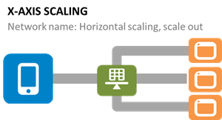
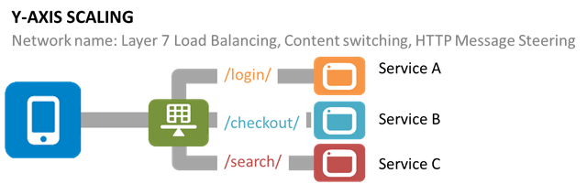
Scaling Challenge

Slide 58
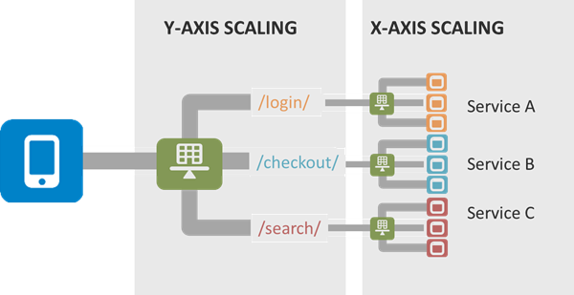
Scaling Challenge

Slide 59
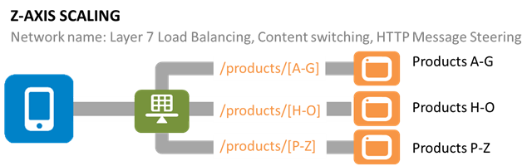
Scaling Challenge

Slide 60
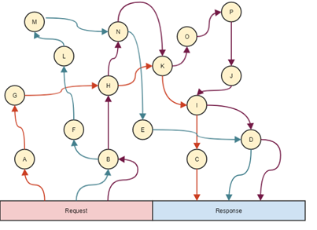
Saga Pattern

Slide 61
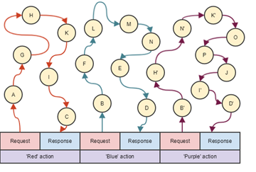
Saga Pattern

Slide 62
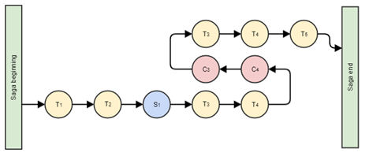
Saga Pattern

Slide 63
Proposed Solutions to Handle Challenges
1. Data Synchronization — We have event sourcing architecture to address this issue using the async messaging platform. The saga design pattern can address this challenge.
2. Security — An API Gateway can solve these challenges. Kong is very popular and is open-source, and is being used by many companies in production. Custom solutions can also be developed for API security using JWT token, Spring Security, and Netflix Zuul/ Zuul2. There are enterprise solutions available, too, like Apigee and Okta (2-step authentication). Openshift is used for public cloud security for its top features, like Red Hat Linux Kernel-based security and namespace-based app-to-app security.
3. Versioning — This will be taken care of by API registry and discovery APIs using the dynamic Swagger API, which can be updated dynamically and shared with consumers on the server.
4. Discovery — This will be addressed by API discovery tools like Kubernetes and OpenShift. It can also be done using Netflix Eureka at the code level. However, doing it in with the orchestration layer will be better and can be managed by these tools rather doing and maintaining it through code and configuration.

Slide 64
Proposed Solutions to Handle Challenges
5. Data Staleness — The database should be always updated to give recent data. The API will fetch data from the recent and updated database. A timestamp entry can also be added with each record in the database to check and verify the recent data. Caching can be used and customized with an acceptable eviction policy based on business requirements.
6. Debugging and Logging — There are multiple solutions for this. Externalized logging can be used by pushing log messages to an async messaging platform like Kafka, Google PubSub, etc. A correlation ID can be provided by the client in the header to REST APIs to track the relevant logs across all the pods/Docker containers. Also, local debugging can be done individually on each microservice using the IDE or checking the logs.
7. Testing — This issue can be addressed with unit testing by mocking REST APIs or integrated/dependent APIs which are not available for testing using WireMock, BDD, Cucumber, integration testing, performance testing using JMeter, and any good profiling tool like Jprofiler, DynaTrace, YourToolKit, VisualVM, etc.

Slide 65
Proposed Solutions to Handle Challenges
8. Monitoring — Monitoring can be done using open-source tools like Prometheus in combination with Grafana by creating gauge and matrices, Kubernetes/OpensShift, Influx DB, Apigee, combined with Grafana, and Graphite.
9. DevOps Support — Microservices deployment and support-related challenges can be addressed using state-of-the-art DevOps tools like GCP, Kubernetes, and OpenShift with Jenkins.
10. Fault Tolerance — Netflix Hystrix can be used to break the circuit if there is no response from the API for the given SLA/ETA.

Slide 66
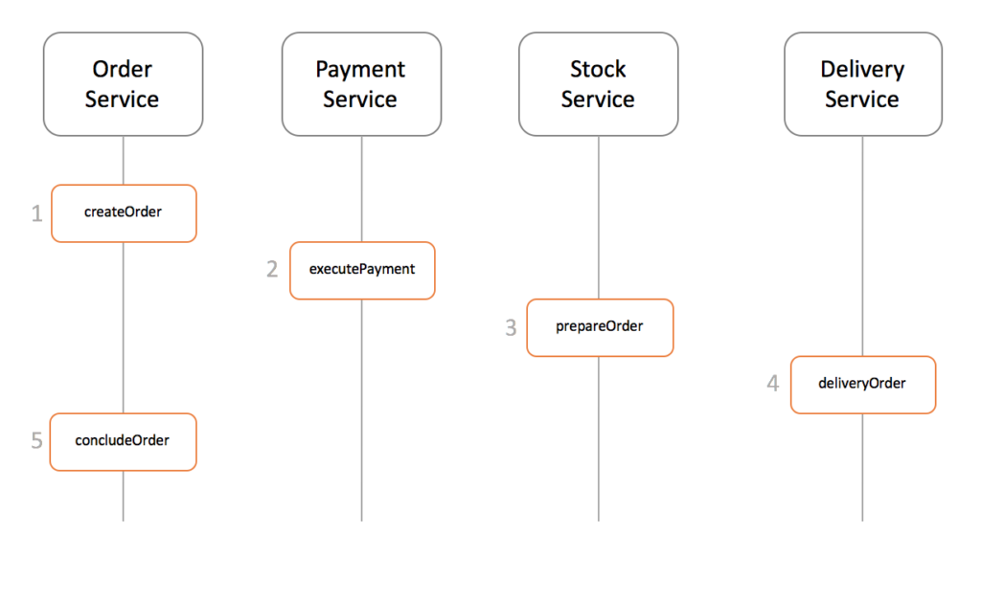
Saga Design Pattern

Slide 67
Saga Design Pattern
Events/Choreography: When there is no central coordination, each service produces and listen to other service’s events and decides if an action should be taken or not.
Command/Orchestration: when a coordinator service is responsible for centralizing the saga’s decision making and sequencing business logic

Slide 68
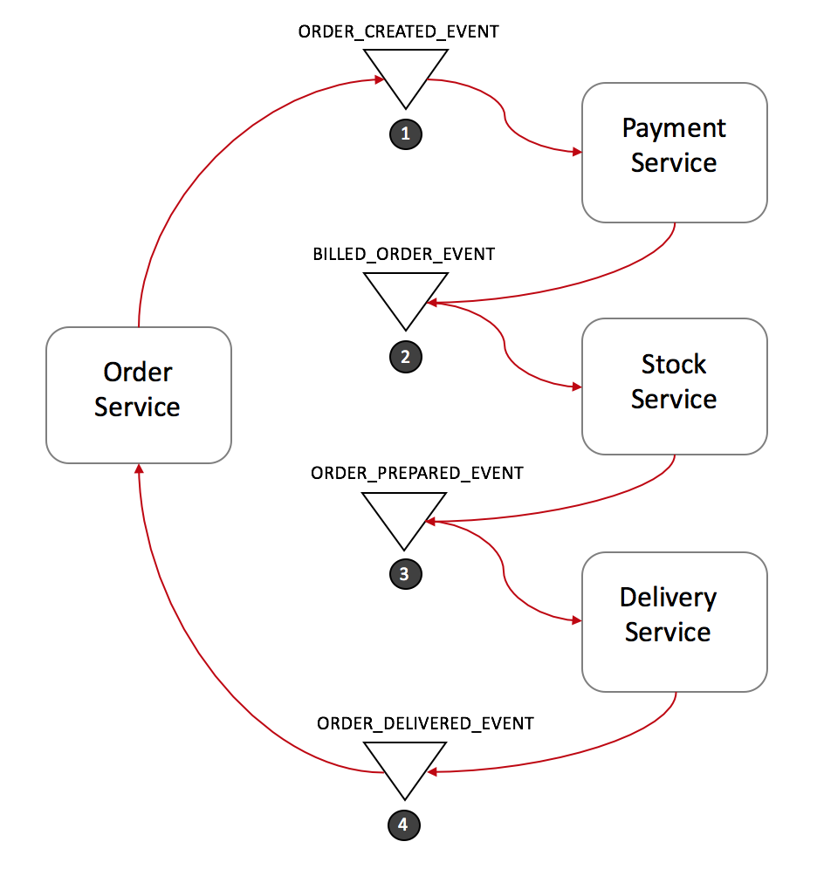
Event Choreography

Slide 69
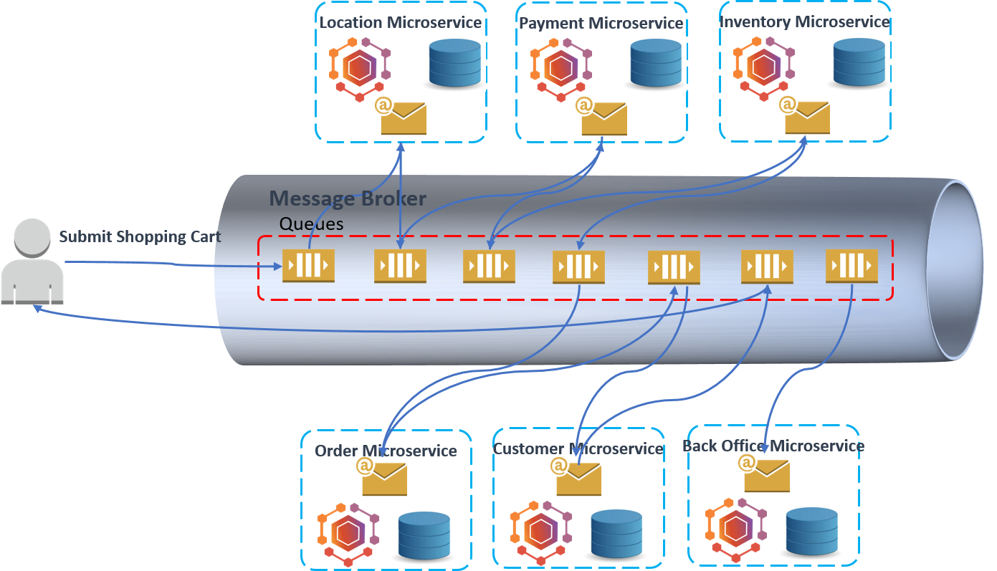
Event Choreography

Slide 70
Event-Driven Service Choreography
Difficult to maintain: Due to the decentralized solution, the business flow is spreading across multiple services. Any business change to the process flow will lead to changes in multiple services.
Difficult to manage: The runtime state of the process instance is stored separately.
Difficult to rollback: The business process is choreographed by multiple services which leave the transaction’s ACID becomes extremely difficult.

Slide 71
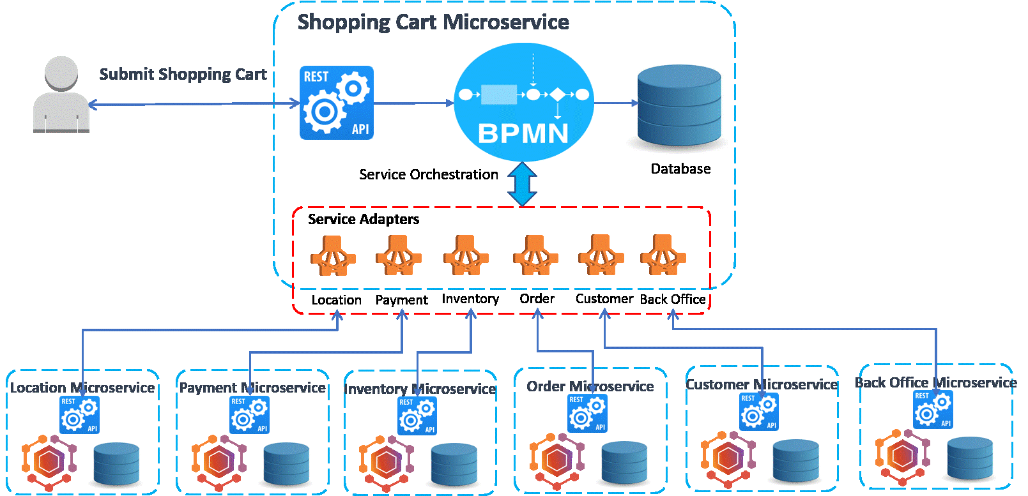
Event Choreography

Slide 72
Centralized Service Orchestration
Easy to maintain: the business flow is modeled as graphical BPMN process in a centralized orchestration microservice. The standard Business Process Model and Notation (BPMN) grants the businesses with the capability of understanding their internal business procedures in a graphical notation. Furthermore, organizations can better communicate and report these procedures in a standard manner. Any further changes to the process flow will be mitigated by implementing the workflow diagrams.
Easy to manage: BPMN process engine keeps track of all process instances, their state, audit and statistics information.
Easy to rollback: Transaction's ACID can be guaranteed by the compensation flow as the BPMN out-of-the-box feature.

Slide 73
Centralized Service Orchestration
Tight-coupling: The orchestration pattern must build and maintain a point-to-point connection between the services. Point-to-point means that one service calls the API of another service which results in a mesh of communication paths between all services. Integrating, changing or removing services from the service repository will be a hard task since you must be aware of each connection between the services.
Complexity in building service adapters: Orchestration service need to develop adapters to the peer services, which must maintain all details of the service communications, such as service location, service interfaces, and data model translation. Whenever a peer service changes, the adapter will be impacted.

Slide 74
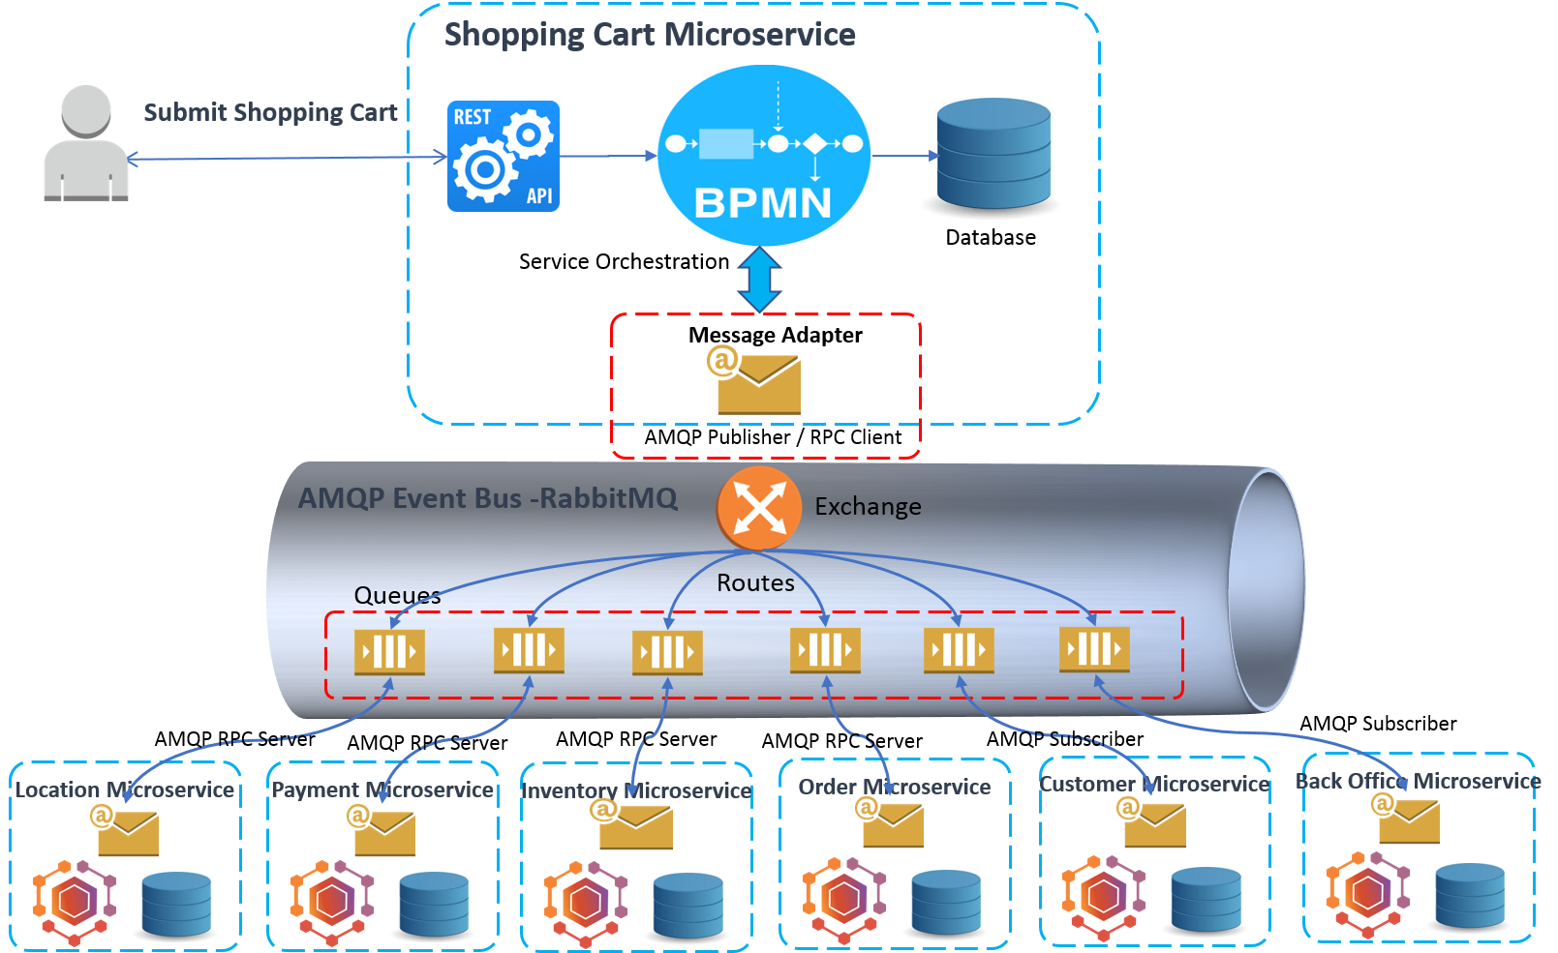
Event Choreography

Slide 75
Solutions to Challenges with Microservice Architectures
Spring Boot
Enable building production ready applications quickly
Provide non-functional features
embedded servers (easy deployment with containers)
metrics (monitoring)
health checks (monitoring)
externalized configuration

Slide 76
Solutions to Challenges with Microservice Architectures
Spring Cloud
Spring Cloud provides solutions to cloud enable your microservices.
It leverages and builds on top of some of the Cloud solutions opensourced by Netflix (Netflix OSS).

Slide 77
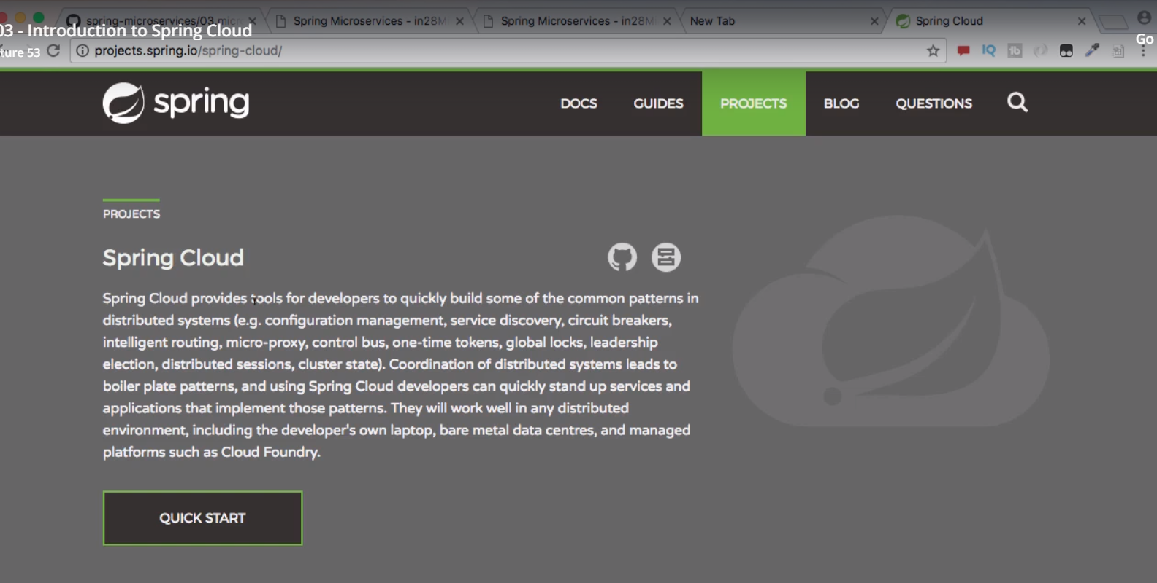
Spring Cloud

Slide 78
Spring Cloud
Spring Cloud provides tools for developers to quickly build some of the common patterns in distributed systems (e.g. configuration management, service discovery, circuit breakers, intelligent routing, micro-proxy, control bus, one-time tokens, global locks, leadership election, distributed sessions, cluster state).
Coordination of distributed systems leads to boiler plate patterns, and using Spring Cloud developers can quickly stand up services and applications that implement those patterns.
They will work well in any distributed environment, including the developer’s own laptop, bare metal data centres, and managed platforms such as Cloud Foundry.

Slide 79
Spring Cloud Main Projects
Spring Cloud Config
Centralized external configuration management backed by a git repository.
The configuration resources map directly to Spring Environment but could be used by non-Spring applications if desired.
Spring Cloud Netflix
Integration with various Netflix OSS components (Eureka, Hystrix, Zuul, Archaius, etc.).

Slide 80
Spring Cloud Main Projects
Spring Cloud Bus
An event bus for linking services and service instances together with distributed messaging. Useful for propagating state changes across a cluster (e.g. config change events).
Spring Cloud Cloudfoundry
Integrates your application with Pivotal Cloud Foundry. Provides a service discovery implementation and also makes it easy to implement SSO and OAuth2 protected resources.

Slide 81
Spring Cloud Main Projects
Spring Cloud Open Service Broker
Provides a starting point for building a service broker that implements the Open Service Broker API.
Spring Cloud Cluster
Leadership election and common stateful patterns with an abstraction and implementation for Zookeeper, Redis, Hazelcast, Consul.

Slide 82
Spring Cloud Main Projects
Spring Cloud Consul
Service discovery and configuration management with Hashicorp Consul.
Spring Cloud Security
Provides support for load-balanced OAuth2 rest client and authentication header relays in a Zuul proxy.
Spring Cloud Sleuth
Distributed tracing for Spring Cloud applications, compatible with Zipkin, HTrace and log-based (e.g. ELK) tracing.

Slide 83
Spring Cloud Main Projects
Spring Cloud Data Flow
A cloud-native orchestration service for composable microservice applications on modern runtimes. Easy-to-use DSL, drag-and-drop GUI, and REST-APIs together simplifies the overall orchestration of microservice based data pipelines.
Spring Cloud Stream
A lightweight event-driven microservices framework to quickly build applications that can connect to external systems. Simple declarative model to send and receive messages using Apache Kafka or RabbitMQ between Spring Boot apps.

Slide 84
Spring Cloud Main Projects
Spring Cloud Stream App Starters
Spring Cloud Stream App Starters are Spring Boot based Spring Integration applications that provide integration with external systems.
Spring Cloud Task
A short-lived microservices framework to quickly build applications that perform finite amounts of data processing. Simple declarative for adding both functional and non-functional features to Spring Boot apps.

Slide 85
Spring Cloud Main Projects
Spring Cloud Task App Starters
Spring Cloud Task App Starters are Spring Boot applications that may be any process including Spring Batch jobs that do not run forever, and they end/stop after a finite period of data processing.
Spring Cloud Zookeeper
Service discovery and configuration management with Apache Zookeeper.

Slide 86
Spring Cloud Main Projects
Spring Cloud AWS
Easy integration with hosted Amazon Web Services. It offers a convenient way to interact with AWS provided services using well-known Spring idioms and APIs, such as the messaging or caching API. Developers can build their application around the hosted services without having to care about infrastructure or maintenance.
Spring Cloud Connectors
Makes it easy for PaaS applications in a variety of platforms to connect to backend services like databases and message brokers (the project formerly known as "Spring Cloud").

Slide 87
Spring Cloud Main Projects
Spring Cloud Starters
Spring Boot-style starter projects to ease dependency management for consumers of Spring Cloud. (Discontinued as a project and merged with the other projects after Angel.SR2.)
Spring Cloud CLI
Spring Boot CLI plugin for creating Spring Cloud component applications quickly in Groovy
Spring Cloud Contract
Spring Cloud Contract is an umbrella project holding solutions that help users in successfully implementing the Consumer Driven Contracts approach.

Slide 88
Spring Cloud Main Projects
Spring Cloud Gateway
Spring Cloud Gateway is an intelligent and programmable router based on Project Reactor.
Spring Cloud OpenFeign
Spring Cloud OpenFeign provides integrations for Spring Boot apps through autoconfiguration and binding to the Spring Environment and other Spring programming model idioms.
Spring Cloud Pipelines
Spring Cloud Pipelines provides an opinionated deployment pipeline with steps to ensure that your application can be deployed in zero downtime fashion and easilly rolled back of something goes wrong.

Slide 89
Spring Cloud Main Projects
Spring Cloud Function
Spring Cloud Function promotes the implementation of business logic via functions. It supports a uniform programming model across serverless providers, as well as the ability to run standalone (locally or in a PaaS).
.

Slide 90
Spring Cloud Config Server
Spring Cloud Config provides server and client-side support for externalized configuration in a distributed system.
With the Config Server you have a central place to manage external properties for applications across all environments.
The concepts on both client and server map identically to the Spring Environment and PropertySource abstractions, so they fit very well with Spring applications, but can be used with any application running in any language.

Slide 91
Spring Cloud Config Server
As an application moves through the deployment pipeline from dev to test and into production you can manage the configuration between those environments and be certain that applications have everything they need to run when they migrate.
The default implementation of the server storage backend uses git so it easily supports labelled versions of configuration environments, as well as being accessible to a wide range of tooling for managing the content. It is easy to add alternative implementations and plug them in with Spring configuration.

Slide 92
Features
Spring Cloud Config Server features:
HTTP, resource-based API for external configuration (name-value pairs, or equivalent YAML content)
Encrypt and decrypt property values (symmetric or asymmetric)
Embeddable easily in a Spring Boot application using @EnableConfigServer

Slide 93
Client side Features
Config Client features (for Spring applications):
Bind to the Config Server and initialize Spring Environment with remote property sources
Encrypt and decrypt property values (symmetric or asymmetric)

Slide 94
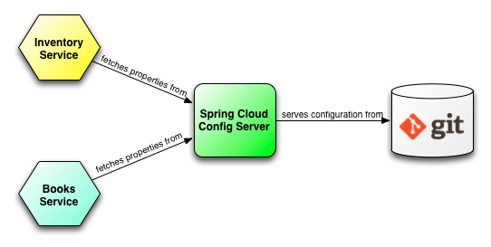
Spring Cloud Config Server

Slide 95
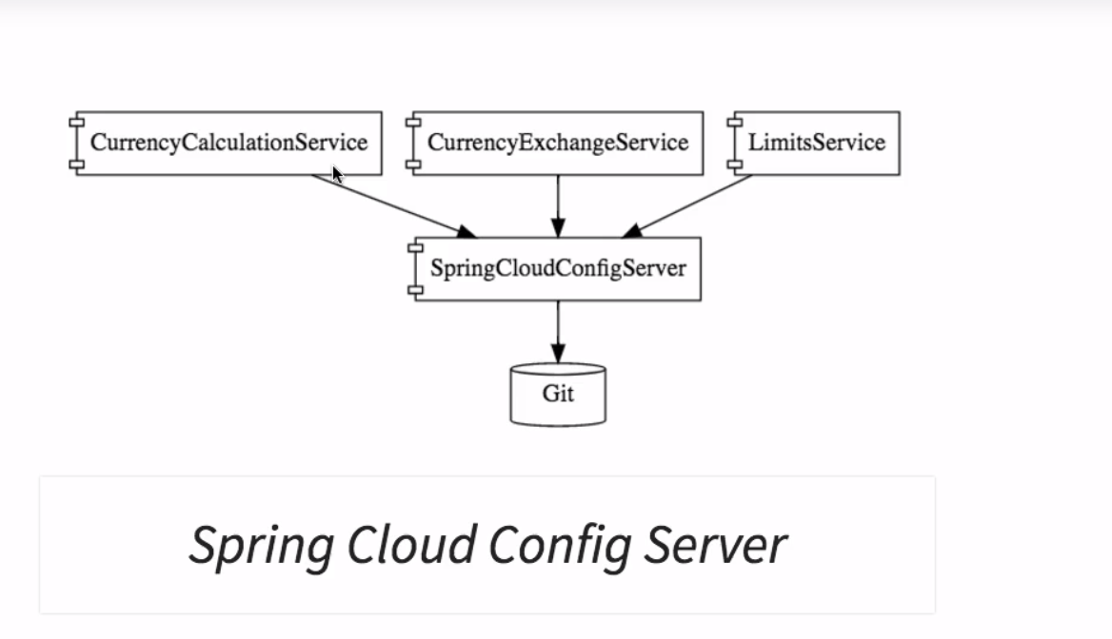
Spring Cloud

Slide 96
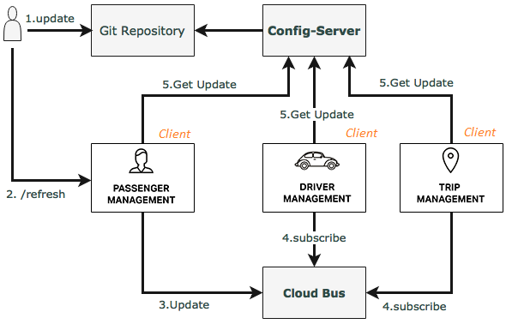
Spring Cloud Bus

Slide 97
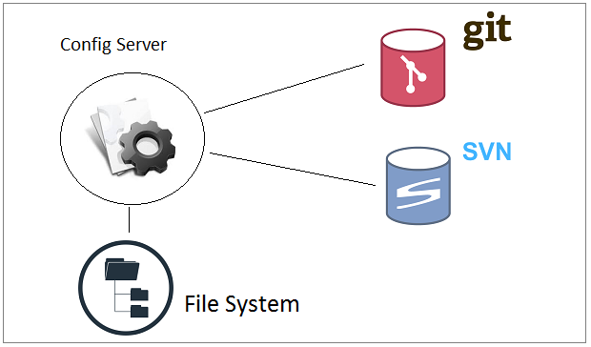
How does Config Server Store Data

Slide 98
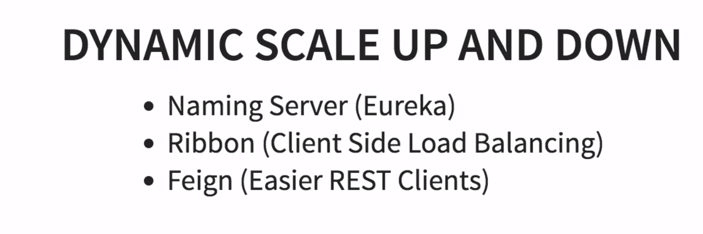
Spring Cloud

Slide 99
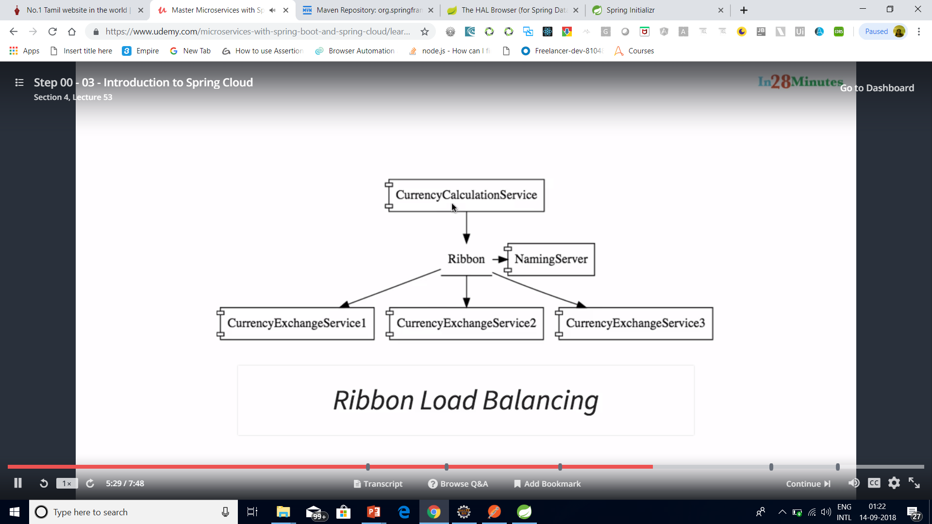
Spring Cloud

Slide 100
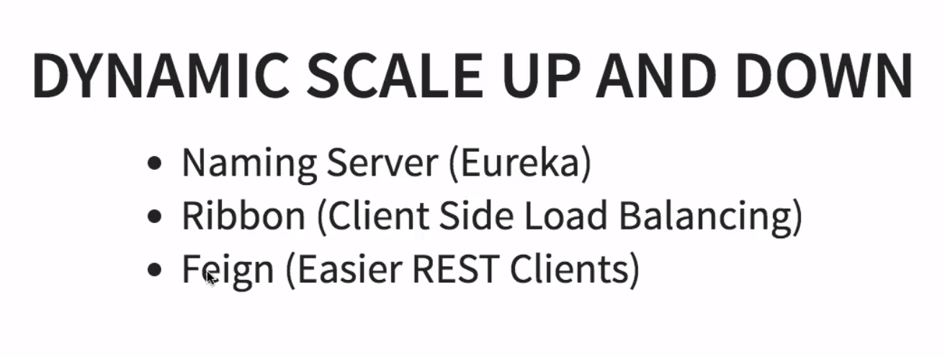
Spring Cloud

Slide 101
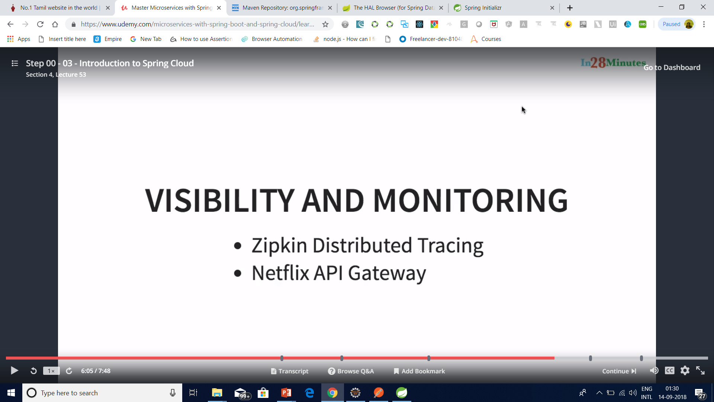
Spring Cloud

Slide 102
Important Spring Cloud Modules
Dynamic Scale Up and Down. Using a combination of
Naming Server (Eureka)
Ribbon (Client Side Load Balancing)
Feign (Easier REST Clients)
Visibility and Monitoring with
Zipkin Distributed Tracing
Netflix API Gateway
Configuration Management with
Spring Cloud Config Server
Fault Tolerance with
Hystrix

Slide 103
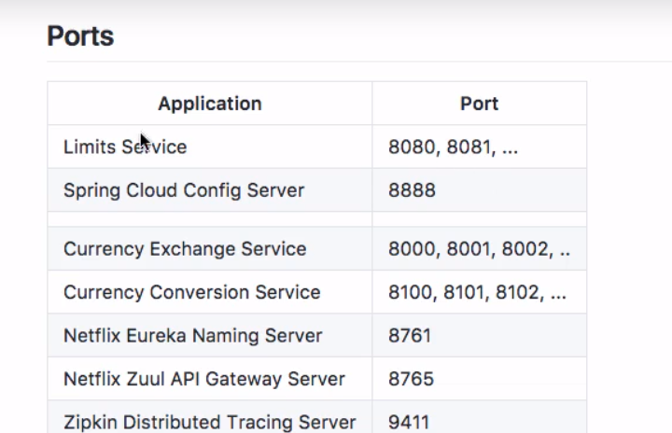
Standardized ports

Slide 104
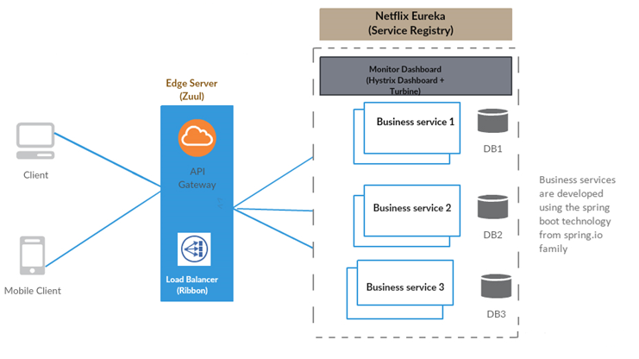

Slide 105

Distributed tracing system with request visualization.
Monitoring, routing and security
client side Load Balancers

Slide 106

Spring Boot and Microservices

Slide 107
Why Eureka Server
In the distributed computing are there is a concept called ‘Service registration and discovery’ where one dedicated server is responsible to maintain the registry of all the Microservice that has been deployed and removed. This will act like a phone book of all other applications/microservices.

Slide 108

Spring Cloud Service Discovery with Netflix Eureka

Slide 109
Server Configuration
server:
port: ${PORT:8761} # Indicate the default PORT where this service will be started
eureka:
client:
registerWithEureka: false #telling the server not to register himself in the service registry
fetchRegistry: false
server:
waitTimeInMsWhenSyncEmpty: 0 #wait time for subsequent sync

Slide 110
Client Configuration
server:
port: 8098 #default port where the service will be started
eureka: #tells about the Eureka server details and its refresh time
instance:
leaseRenewalIntervalInSeconds: 1
leaseExpirationDurationInSeconds: 2
client:

Slide 111
Client Configuration
serviceUrl:
defaultZone: http://127.0.0.1:8761/eureka/
healthcheck:
enabled: true
lease:
duration: 5
spring:
application:
name: student-service #current service name to be used by the eureka server

Slide 112
Client Configuration
management:
security:
enabled: false #disable the spring security on the management endpoints like /env, /refresh etc.
logging:
level:
com.example.howtodoinjava: DEBUG

Slide 113
Consul Service Registration and Discovery Example
Consul provides multiple features like service discovery, configuration management, health checking and key-value store etc.

Slide 114

Consul Service Registration and Discovery Example
Consul Agent – running on localhost acting as discovery/registry server functionality.

Slide 115
Configuring Consul in Local workstation
Download from Consul portal. Choose particular package based on the operating System. Once downloaded the zip, we need to unzip it to desired place.
Start Consul Agent in local workstation – The Zip file that we have unzipped, has only one exe file called consul.exe. We will start a command prompt here and use below command to start the agent.
consul agent -server -bootstrap-expect=1 -data-dir=consul-data -ui -bind=192.168.99.1

Slide 116

Configuring Consul in Local workstation
Make sure you enter the correct bind address, it would be different depending on the LAN settings. Do a ipconfig in command prompt to know your IpV4 address and use it here.

Slide 117

Configuring Consul in Local workstation

Slide 118

Configuring Consul in Local workstation
Test whether Consul Server is running – Consul runs on default port and once agent started successfully, browse http://localhost:8500/uiand you should see a console screen like –

Slide 119
Consul Client
Create Student Project
Create a Spring boot project from initializer portal with four dependencies i.e.
Actuator
Web
Rest Repositories
Consul Discovery

Slide 120
Service Configuration
server.port=9098 – will start the service in default 9098 port.
spring.application.name: student-service – will registers itself in consul server using student-service tag and also other services will lookup this service with this name itself.
management.security.enabled=false – is not actually required for this exercise, but it will disable spring security in the management endpoints provided by actuator module.

Slide 121
Hystrix Circuit Breaker Pattern – Spring Cloud
It is generally required to enable fault tolerance in the application where some underlying service is down/throwing error permanently, we need to fall back to different path of program execution automatically.
This is related to distributed computing style of Eco system using lots of underlying Microservices.
This is where circuit breaker pattern helps and Hystrix is an tool to build this circuit breaker.

Slide 122
What is Circuit Breaker Pattern?
If we design our systems on microservice based architecture, we will generally develop many Microservices and those will interact with each other heavily in achieving certain business goals.
Now, all of us can assume that this will give expected result if all the services are up and running and response time of each service is satisfactory.

Slide 123
What is Circuit Breaker Pattern?
Now what will happen if any service, of the current Eco system, has some issue and stopped servicing the requests.
It will result in timeouts/exception and the whole Eco system will get unstable due to this single point of failure.

Slide 124
What is Circuit Breaker Pattern?
Here circuit breaker pattern comes handy and it redirects traffic to a fall back path once it sees any such scenario.
Also it monitors the defective service closely and restore the traffic once the service came back to normalcy.

Slide 125
What is Circuit Breaker Pattern?
So circuit breaker is a kind of a wrapper of the method which is doing the service call and it monitors the service health and once it gets some issue, the circuit breaker trips and all further calls goto the circuit breaker fall back and finally restores automatically once the service came back !! That’s cool right?

Slide 126

What is Circuit Breaker Pattern?

Slide 127
Hystrix Dashboard
http://localhost:9091/hystrix
http://localhost:9091/actuator/hystrix.stream – It’s a continuous stream that Hystrix generates. It is just a health check result along with all the service calls that are being monitored by Hystrix. Sample output will look like in browser –

Slide 128


Slide 129


Slide 130


Slide 131


Slide 132
Using Blue-Green Deployment to Reduce Downtime and Risk
Blue-green deployment is a technique that reduces downtime and risk by running two identical production environments called Blue and Green.
At any time, only one of the environments is live, with the live environment serving all production traffic. For this example, Blue is currently live and Green is idle.

Slide 133
Using Blue-Green Deployment to Reduce Downtime and Risk
As you prepare a new version of your software, deployment and the final stage of testing takes place in the environment that is not live: in this example, Green.
Once you have deployed and fully tested the software in Green, you switch the router so all incoming requests now go to Green instead of Blue. Green is now live, and Blue is idle.

Slide 134

Blue-Green Deployment with Cloud Foundry
$ cf push Blue -n demo-time

Slide 135

Blue-Green Deployment with Cloud Foundry
$ cf push Green -n demo-time-temp

Slide 136

Blue-Green Deployment with Cloud Foundry
$ cf map-route Green example.com -n demo-time
Binding demo-time.example.com to Green... OK

Slide 137

Blue-Green Deployment with Cloud Foundry
$ cf unmap-route Blue example.com -n demo-time
Unbinding demo-time.example.com from blue... OK

Slide 138

Blue-Green Deployment with Cloud Foundry
cf delete-route

Slide 139
How to Deploy Spring Boot Application to Cloud Foundry Platform
Cloud Foundry is one of the Cloud Providers. It is a PaaS service where we can easily deploy and manage our applications and the Cloud Foundry will take care of the rest of the cloud based offerings like scalability, high availability etc.

Slide 140
What is Cloud Foundry
Cloud Foundry is an open-source platform as a service (PaaS) that provides you with a choice of clouds, developer frameworks, and application services.
It is open source and it is governed by the Cloud Foundry Foundation.
The original Cloud Foundry was developed by VMware and currently it is managed by Pivotal, a joint venture company by GE, EMC and VMware.

Slide 141
What is Cloud Foundry
Now since Cloud Foundry is open source product many popular organizations currently provides this platform separately and below are the list of current certified providers.
Pivotal Cloud Foundry
IBM Bluemix
HPE Helion Stackato 4.0
Atos Canopy
CenturyLink App Fog
GE Predix
Huawei FusionStage
SAP Cloud Platform
Swisscom Application Cloud

Slide 142
Cloud Foundry Installation for Windows
Download the CF Windows installer. It will prompt for the download. Save the zip file distribution.
Unpack the zip file to a suitable place in your workstation.
After successfully unzip operation, double cick on the cf CLI executable.
When prompted, click Install, then Close. Here are the sample steps for the same. This is very straight froward, you can select the default values.

Slide 143
Cloud Foundry Installation for Windows
Verify the installation by opening a terminal window and type cf. If your installation was successful, the cf CLI help listing appears. This indicates that you are ready to go with any cloud foundry platform from your local workstation.

Slide 144

Setup PWS Console

Slide 145
Login and logout from PWS Console using CLI
Login to PWS – We will use cf login -a api.run.pivotal.io command to login to pivotal web service console from CLI tool that we have installed in our local workstation. It will logon the CLI tool to PWS platform so that we can deploy and manage our applications from our workstation. After giving command, it will ask for registered email and password and once provided successfully, it will logon to the platform.
Logout from PWS Console – We will use command cf logout to logout from the platform, once we have all the work done for that session.

Slide 146

Create Database in cloud foundry

Slide 147

Push Application to Console
cf push kyc-cf -p target\spring-helloworld-cf-0.0.1-SNAPSHOT.jar

Slide 148

Verify Application Deployed

Slide 149
What is Zuul?
Zuul is the front door for all requests from devices and web sites to the backend of the Netflix streaming application.
As an edge service application, Zuul is built to enable dynamic routing, monitoring, resiliency and security.
It also has the ability to route requests to multiple Amazon Auto Scaling Groups as appropriate.

Slide 150

What is Zuul?

Slide 151

What is Zuul?

Slide 152


Slide 153
Why did we build Zuul?
The volume and diversity of Netflix API traffic sometimes results in production issues arising quickly and without warning.
We need a system that allows us to rapidly change behaviour in order to react to these situations.

Slide 154
Zuul Components
Zuul has mainly four types of filters that enable us to intercept the traffic in different timeline of the request processing for any particular transaction.
We can add any number of filters for a particular url pattern.
pre filters – are invoked before the request is routed.
post filters – are invoked after the request has been routed.

Slide 155
Zuul Components
route filters – are used to route the request.
error filters – are invoked when an error occurs while handling the request.

Slide 156

Zuul Components

Slide 157
Zuul Filters Responsibilities
Apply microservice authentication and security in the gateway layer to protect the actual services
We can do microservices insights and monitoring of all the traffic that are going in to the ecosystem by enabling some logging to get meaningful data and statistics at the edge in order to give us an accurate view of production.

Slide 158
Zuul Filters Responsibilities
Dynamic Routing can route requests to different backend clusters as needed.
We can do runtime stress testing by gradually increasing the traffic to a new cluster in order to gauge performance in many scenarios e.g. cluster has new H/W and network setup or that has new version of production code deployed.

Slide 159
Zuul Filters Responsibilities
We can do dynamic load shedding i.e. allocating capacity for each type of request and dropping requests that go over the limit.
We can apply static response handling i.e. building some responses directly at the edge instead of forwarding them to an internal cluster for processing.

Slide 160

Spring Cloud Config Server with git

Slide 161
Docker
Docker is an excellent tool for managing and deploying microservices.
Each microservice can be further broken down into processes running in separate Docker containers, which can be specified with Dockerfiles and Docker Compose configuration files.
Combined with a provisioning tool such as Kubernetes, each microservice can then be easily deployed, scaled, and collaborated on by a developer team.
Specifying an environment in this way also makes it easy to link microservices together to form a larger application.

Slide 162
Asynchronous communication in Microservices
Kafka
RabbitMQ
Google Pub/Sub
Amazon Services
ActiveMQ
Azure Services

Slide 163

Kafka architecture

Slide 164

Kafka architecture

Slide 165


Slide 166
RabbitMQ
The super simplified overview:
Publishers send messages to exchanges
Exchanges route messages to queues and other exchanges
RabbitMQ sends acknowledgements to publishers on message receipt
Consumers maintain persistent TCP connections with RabbitMQ and declare which queue(s) they consume
RabbitMQ pushes messages to consumers
Consumers send acknowledgements of success/failure
Messages are removed from queues once consumed successfully

Slide 167


Slide 168

Docker

Slide 169


Slide 170
What is Docker
What is Docker?
At its heart, Docker is software which lets you create an image and then run instances of that image in a container.
Docker maintain a vast repository of images, called the Docker Hub which you can use as starting points or as free storage for your own images.
You can install Docker, choose an image you'd like to use, then run an instance of it in a container.

Slide 171
Difference between VM and Container
Applications running in virtual machines, apart from the hypervisor, require a full instance of the operating system and any supporting libraries.
Containers, on the other hand, share the operating system with the host.
Hypervisor is comparable to the container engine (represented as Docker on the image) in a sense that it manages the lifecycle of the containers.
The important difference is that the processes running inside the containers are just like the native processes on the host, and do not introduce any overheads associated with hypervisor execution.
Additionally, applications can reuse the libraries and share the data between containers.

Slide 172
Dockerfile, Docker Image And Docker Container:
A Docker Image is created by the sequence of commands written in a file called as Dockerfile.
When this Dockerfile is executed using a docker command it results into a Docker Image with a name.
When this Image is executed by “docker run” command it will by itself start whatever application or service it must start on its execution.

Slide 173


Slide 174


Slide 175


Slide 176

Docker

Slide 177

Docker Architecture

Slide 178
Docker Hub:
Docker Hub is like GitHub for Docker Images. It is basically a cloud registry where you can find Docker Images uploaded by different communities, also you can develop your own image and upload on Docker Hub, but first, you need to create an account on DockerHub.

Slide 179

Docker Hub

Slide 180
Docker Architecture
It consists of a Docker Engine which is a client-server application with three major components:
A server which is a type of long-running program called a daemon process (the docker command).
A REST API which specifies interfaces that programs can use to talk to the daemon and instruct it what to do.
A command line interface (CLI) client (the docker command).
The CLI uses the Docker REST API to control or interact with the Docker daemon through scripting or direct CLI commands. Many other Docker applications use the underlying API and CLI.

Slide 181
Docker Architecture
By default, the main registry is the Docker Hub which hosts public and official images.
Organizations can also host their private registries if they desire.
Images can be downloaded from registries explicitly (docker pull imageName) or implicitly when starting a container. Once the image is downloaded it is cached locally.
Containers are the instances of images - they are the living thing. There could be multiple containers running based on the same image.

Slide 182
Docker Architecture
At the center, there is the Docker daemon responsible for creating, running, and monitoring containers.
It also takes care of building and storing images.
Finally, on the left-hand side there is a Docker client. It talks to the daemon via HTTP.
Unix sockets are used when on the same machine, but remote management is possible via HTTP based API.

Slide 183

Goals of Docker Networking

Slide 184
Creating Test Database Server
This is a great Docker use case.
We might not want to run our production database in Docker (perhaps we'll just use Amazon RDS for example), but we can spin up a clean MySQL database in no time as a Docker container for development - leaving our development machine clean and keeping everything we do controlled and repeatable.

Slide 185
Docker Compose
Docker Compose is basically used to run multiple Docker Containers as a single server. Let me give you an example:
Suppose if I have an application which requires WordPress, Maria DB and PHP MyAdmin. I can create one file which would start both the containers as a service without the need to start each one separately. It is really useful especially if you have a microservice architecture.

Slide 186
Docker Container
Column | Description
Container ID | The unique ID of the container. It is a SHA-256.
Image | The name of the container image from which this container is instantiated.
Status | The status of the container (created, restarting, running, removing, paused, exited, or dead).
Ports | The list of container ports that have been mapped to the host.
Names | The name assigned to this container (multiple names are possible).

Slide 187
Docker Client and Docker Engine
Docker Client : This is the utility we use when we run any docker commands e.g. docker run (docker container run) , docker images , docker ps etc. It allows us to run these commands which a human can easily understand.
Docker Daemon/Engine: This is the part which does rest of the magic and knows how to talk to the kernel, makes the system calls to create, operate and manage containers, which we as users of docker dont have to worry about.

Slide 188
Creating Test Database Server
docker run --name olddb -e MYSQL_ROOT_PASSWORD=vignesh –e MYSQL_DATABASE=virtusa_2018db –e MYSQL_USER=root -p 3306:3306 mysql/mysql-server:5.5
docker run tells the engine we want to run an image (the image comes at the end, mysql:vlatest
--name db names this container db.
-d detach - i.e. run the container in the background.
-e MYSQL_ROOT_PASSWORD=123 the -e is the flag that tells docker we want to provide an environment variable. The variable following it is what the MySQL image checks for setting the default root password.
-p 3306:3306 tells the engine that we want to map the port 3306 from inside the container to out port 3306.

Slide 189


Slide 190

Creating Test Database Server
Docker ps
docker exec -it olddb /bin/bash
mysql –u root –p

Slide 191
Springboot Docker
<plugin>
<groupId>com.spotify</groupId>
<artifactId>docker-maven-plugin</artifactId>
<version>VERSION GOES HERE</version>
<configuration>
<imageName>example</imageName>
<baseImage>java</baseImage>
<entryPoint>["java", "-jar", "/${project.build.finalName}.jar"]</entryPoint>
<!-- copy the service's jar file from target into the root directory of the image -->
<resources>
<resource>
<targetPath>/</targetPath>
<directory>${project.build.directory}</directory>
<include>${project.build.finalName}.jar</include>
</resource>
</resources>
</configuration>
</plugin>

Slide 192
Springboot Docker
Spring boot Project Build
Goal package docker:build
mvn clean install dockerfile:build
Docker folder created and docker image name example deployed in docker machine
Check docker images
Docker ps

Slide 193
Springboot Docker
Docker run –t –name sampleapp –link v1db –p 8080:8080 example:latest
Example:latest --- image name
--name – container reference
--link – db ref in container
docker run -h 192.168.99.100 -p 7070:7070 -t my-repo/example --name my-repo-image:latest

Slide 194
What Is Kubernetes? An Introduction To Container Orchestration Tool
What Is Kubernetes?
Kubernetes is an open-source container management (orchestration) tool. It’s container management responsibilities include container deployment, scaling & descaling of containers & container load balancing.
Download from
https://github.com/kubernetes/minikube
Under curl - windows
https://kubernetes.io/docs/tasks/tools/install-kubectl/#install-kubectl

Slide 195
What Is Kubernetes? An Introduction To Container Orchestration Tool
Why Use Kubernetes?
Companies out there maybe using Docker or Rocket or maybe simply Linux containers for containerizing their applications. But, whatever it is, they use it on a massive scale. They don’t stop at using 1 or 2 containers in Prod. But rather, 10’s or 100’s of containers for load balancing the traffic and ensuring high availability.
.

Slide 196

Features Of Kubernetes

Slide 197


Slide 198

Minikube –p cluster1 dashboard

Slide 199

Spring Cloud Config Server with git

Slide 200

Spring Cloud Config Server with git

Slide 201

Spring Cloud Config Server with git

Slide 202


Spring Cloud Config Server with git

Slide 203

Micro service With Multiple Port

Slide 204

Micro service With Multiple Port

Slide 205

Micro service With Multiple Port

Slide 206

Feign Client

Slide 207

RIBBON LOAD BALANCER

Slide 208


Slide 209


Slide 210


Slide 211


Slide 212


Slide 213
RIBBON LOAD BALANCER
Ribbon is a client-side load balancer, which gives you a lot of control over the behavior of HTTP and TCP clients.
Ribbon's Client component offers a good set of configuration options such as connection timeouts, retries, retry algorithm (exponential, bounded back off) etc.
Ribbon comes built in with a pluggable and customizable Load Balancing component.

Slide 214
RIBBON LOAD BALANCER
Some of the load balancing strategies offered are listed below:
Simple Round Robin LB
Weighted Response Time LB
Zone Aware Round Robin LB
Random LB

Slide 215
RIBBON LOAD BALANCER
Ribbon provides the following features:
Load balancing
Fault tolerance
Multiple protocols (HTTP, TCP, UDP) support in an asynchronous and reactive model
Caching and batching

Slide 216
RIBBON LOAD BALANCER
Bean Type | Bean Name | Class Name
IClientConfig | ribbonClientConfig | DefaultClientConfigImpl
IRule | ribbonRule | ZoneAvoidanceRule
IPing | ribbonPing | DummyPing
ServerList<Server> | ribbonServerList | ConfigurationBasedServerList
ServerListFilter<Server> | ribbonServerListFilter | ZonePreferenceServerListFilter
ILoadBalancer | ribbonLoadBalancer | ZoneAwareLoadBalancer
ServerListUpdater | ribbonServerListUpdater | PollingServerListUpdater

Slide 217
RIBBON LOAD BALANCER
The properties file (sample-client.properties)
# Max number of retries on the same server (excluding the first try)
sample-client.ribbon.MaxAutoRetries=1
# Max number of next servers to retry (excluding the first server)
sample-client.ribbon.MaxAutoRetriesNextServer=1
# Whether all operations can be retried for this client
sample-client.ribbon.OkToRetryOnAllOperations=true
# Interval to refresh the server list from the source
sample-client.ribbon.ServerListRefreshInterval=2000
#

Slide 218
RIBBON LOAD BALANCER
Connect timeout used by Apache HttpClient
sample-client.ribbon.ConnectTimeout=3000
# Read timeout used by Apache HttpClient
sample-client.ribbon.ReadTimeout=3000
# Initial list of servers, can be changed via Archaius dynamic property at runtime
sample-client.ribbon.listOfServers=www.microsoft.com:80,www.yahoo.com:80,www.google.com:80

Slide 219

API Gateway

Slide 220

Zipkin

Slide 221
AWS Lambda Serverless Environment
What is AWS Lambda?
Amazon explains, AWS Lambda (λ) as a ‘serverless’ compute service, meaning the developers, don’t have to worry about which AWS resources to launch, or how will they manage them, they just put the code on lambda and it runs, it’s that simple! It helps you to focus on core-competency i.e. App Building or the code.

Slide 222
AWS Lambda Serverless Environment
Where will I use AWS Lambda?
AWS Lambda executes your backend code, by automatically managing the AWS resources. When we say ‘manage’, it includes launching or terminating instances, health checkups, auto scaling, updating or patching new updates etc.

Slide 223
AWS Lambda Serverless Environment
So, how does it work?
The code that you want Lambda to run is known as a Lambda function. Now, as we know a function runs only when it is called, right? Here, Event Source is the entity which triggers a Lambda Function, and then the task is executed.

Slide 224
AWS Lambda Serverless Environment
Let’s take an example to understand it more clearly.
Suppose you have an app for image uploading. Now when you upload an image, there are a lot of tasks involved before storing it, such as resizing, applying filters, compression etc.
So, this task of uploading of an image can be defined as an Event Source or the ‘trigger’ that will call the Lambda Function, and then all these tasks can be executed via the Lambda function.

Slide 225


Slide 226
AWS Lambda Serverless Environment
The whole process, as you can see in the diagram, is divided into 5 steps, let’s understand each one of them.
User uploads an image (object) to a source bucket in S3 which has notification attached to it, for Lambda.
The notification is read by S3 and it decides where to send that notification.
S3 sends the notification to Lambda, this notification acts as an invoke call of the lambda function.
Execution role in Lambda can be defined by using IAM (Identity and Access Management) to give access permission for the AWS resources, for this example here it would be S3.
Finally, it invokes the desired lambda function which works on the object which has been uploaded to the S3 bucket.

Slide 227

How AWS Lambda Works?

Slide 228
AWS Lambda Steps
Step 1 − Upload AWS lambda code in any of languages AWS lambda supports, that is NodeJS, Java, Python, C# and Go.
Step 2 − These are few AWS services on which AWS lambda can be triggered.
Step 3 − AWS Lambda which has the upload code and the event details on which the trigger has occurred. For example, event from Amazon S3, Amazon API Gateway, Dynamo dB, Amazon SNS, Amazon Kinesis, CloudFront, Amazon SES, CloudTrail, mobile app etc.

Slide 229
AWS Lambda Steps
Step 4 − Executes AWS Lambda Code only when triggered by AWS services under the scenarios such as −
User uploads files in S3 bucket
http get/post endpoint URL is hit
data is added/updated/deleted in dynamo dB tables
push notification
data streams collection
hosting of website
email sending
mobile app, etc.
Step 5 − Remember that AWS charges only when the AWS lambda code executes, and not otherwise.

Slide 230
Advantages of using AWS Lambda
Ease of working with code(Infrastructure Burden Free)
Log Provision
Billing based on Usage
Multi Language Support
Ease of code authoring and deploying

Slide 231
Disadvantages of using AWS Lambda
It is not suitable for small projects.
You need to carefully analyze your code and decide the memory and timeout. Incase if your function needs more time than what is allocated, it will get terminated as per the timeout specified on it and the code will not be fully executed.
Since AWS Lambda relies completely on AWS for the infrastructure, you cannot install anything additional software if your code demands it.

Slide 232
Events that Trigger AWS Lambda
Entry into a S3 object
Insertion, updation and deletion of data in Dynamo DB table
Push notifications from SNS
GET/POST calls to API Gateway
Headers modification at viewer or origin request/response in CloudFront
Log entries in AWS Kinesis data stream
Log history in CloudTrail

Slide 233
Use Cases of AWS Lambda
S3 Object and AWS Lambda
Amazon S3 passes the event details to AWS Lambda when there is any file upload in S3. The details of the file upload or deletion of file or moving of file is passed to the AWS Lambda.
The code in AWS Lambda can take the necessary step for when it receives the event details. For Example creating thumbnail of the image inserted into S3.

Slide 234
Use Cases of AWS Lambda
DynamoDB and AWS Lambda
DynamoDB can trigger AWS Lambda when there is data added, updated and deleted in the table. AWS Lambda event has all the details of the AWS DynamoDB table about the insert /update or delete.
API Gateway and AWS Lambda
API Gateway can trigger AWS Lambda on GET/POST methods. We can create a form and share details with API Gateway endpoint and use it with AWS Lambda for further processing, for Example, making an entry of the data in DynamoDB table.

Slide 235
Use Cases of AWS Lambda
SNS and AWS Lambda
SNS is used for push notification, sending SMS etc. We can trigger AWS lambda when there is any push notification happening in SNS. We can also send SMS to the phone number from AWS Lambda when it receives the trigger.

Slide 236
Use Cases of AWS Lambda
Scheduled Events and AWS Lambda
Scheduled Events can be used for cron jobs. It can trigger AWS Lambda to carry out the task at regular time pattern.
CloudTrail and AWS Lambda
CloudTrail can be helpful in monitoring the logs on the account. We can use AWS Lambda to further process the CloudTrail logs .

Slide 237
Use Cases of AWS Lambda
Kinesis and AWS Lambda
Kinesis is used to capture/store real time tracking data coming from website clicks, logs, social media feeds and a trigger to AWS Lambda can do additional processing on this logs.

Slide 238
Zipkin server
Download from
download the latest Zipkin server from maven repository and run the executable jar file using below command.
java -jar zipkin-server-2.12.1-exec.jar
Once Zipkin is started, we can see the Web UI at http://localhost:9411/zipkin/

Slide 239

Microservices Interactions

Slide 240
Questions

Slide 241
Module Summary
Spring Integration Framework.
Message, Channel and Adapter
Understood the different Component Integration
Understood the Event-Driven Architecture

